Slide 1
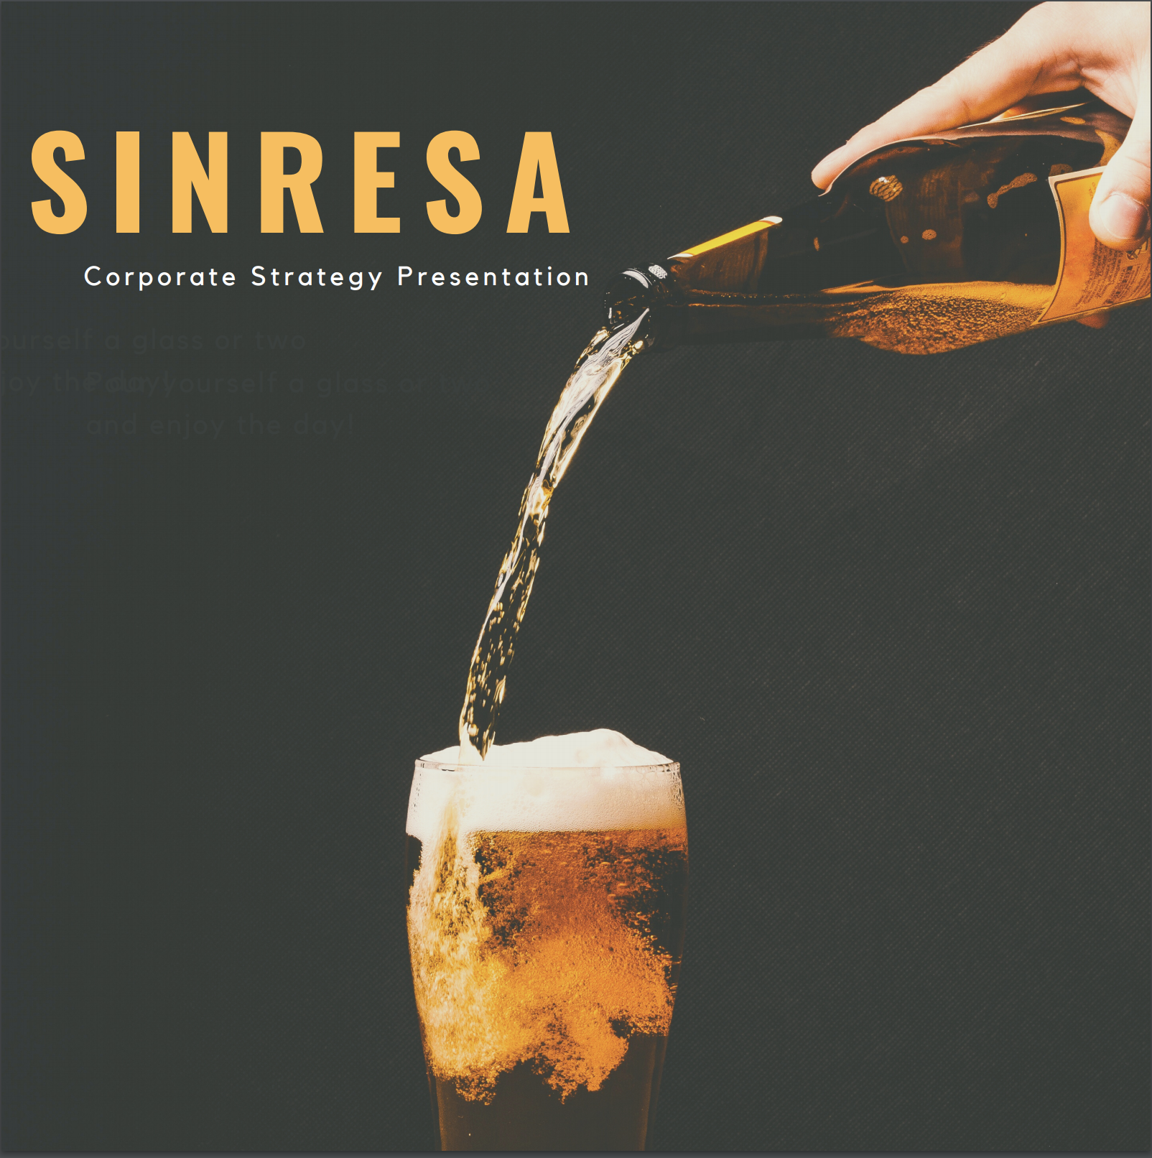

Slide 2
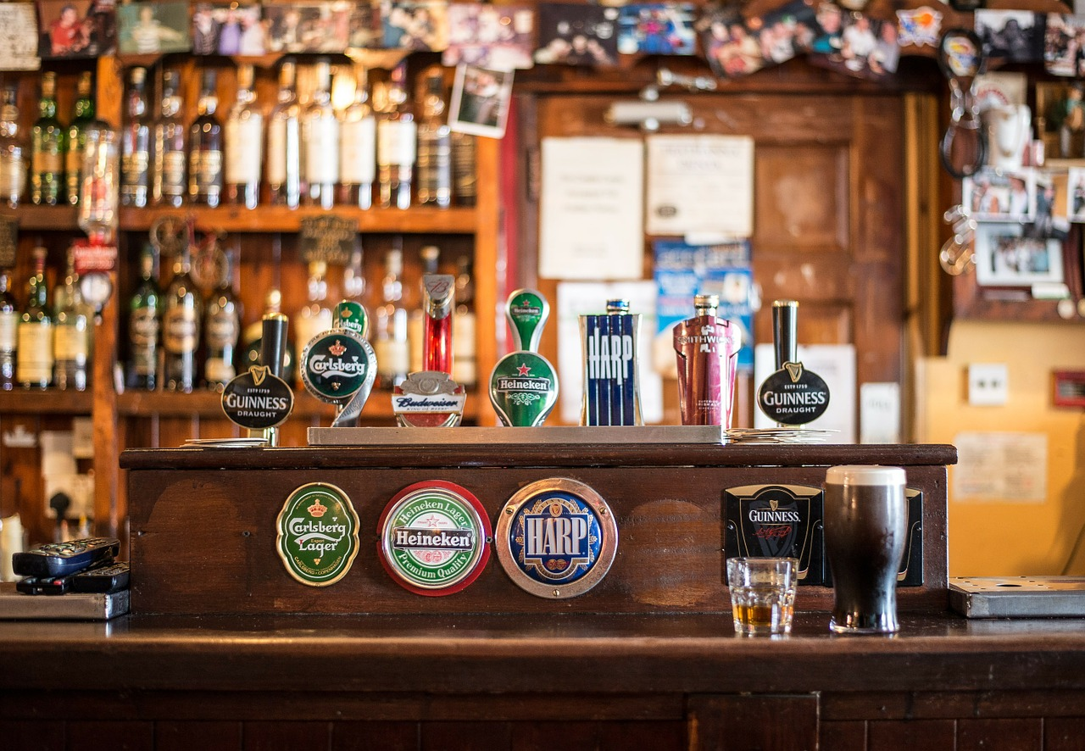
THE DRIVERS

Slide 3
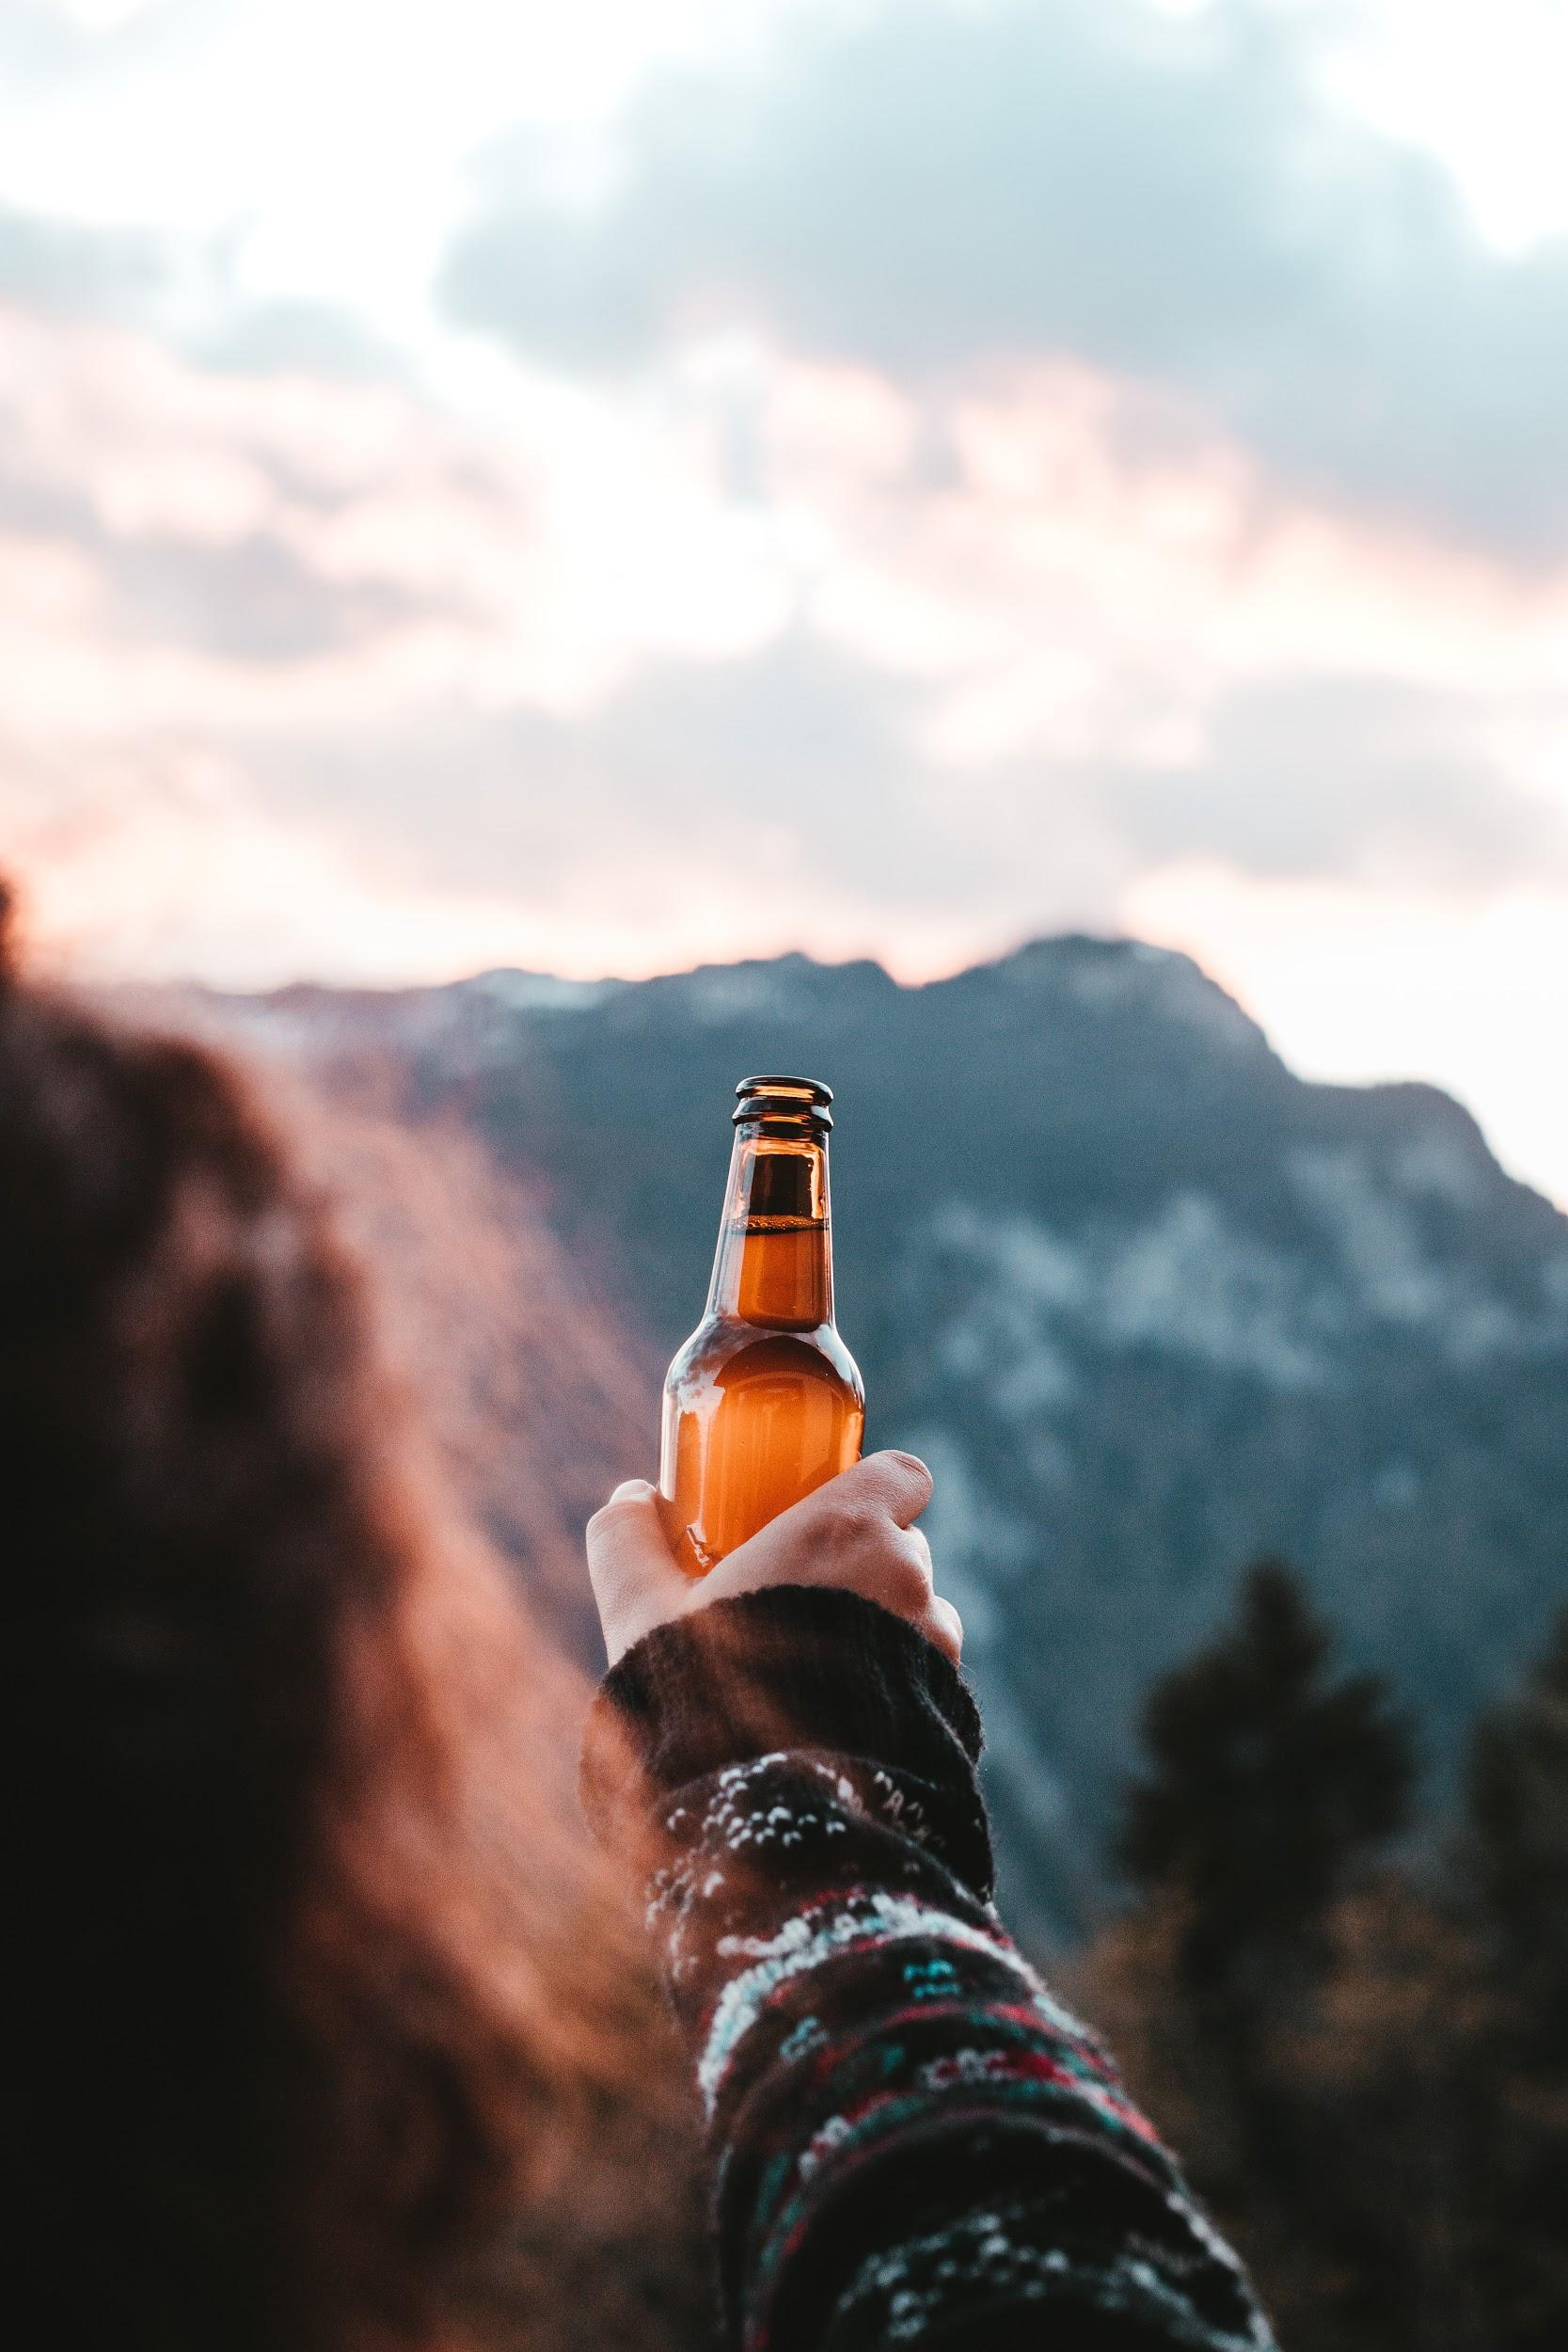
GROWING MARKET
Market size (2018) : 1.36bn

Slide 4
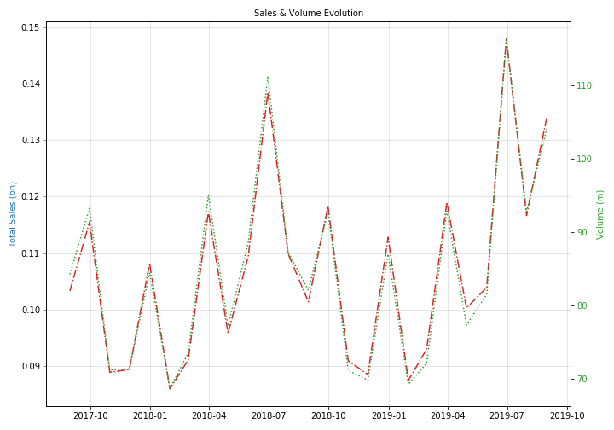
WITH HIGH VOLATILITY

Slide 5
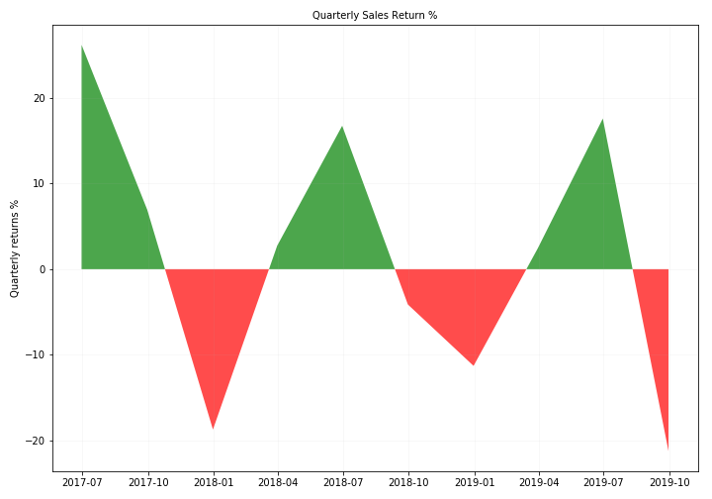
AND QUARTERLY SEASONALITY

Slide 6
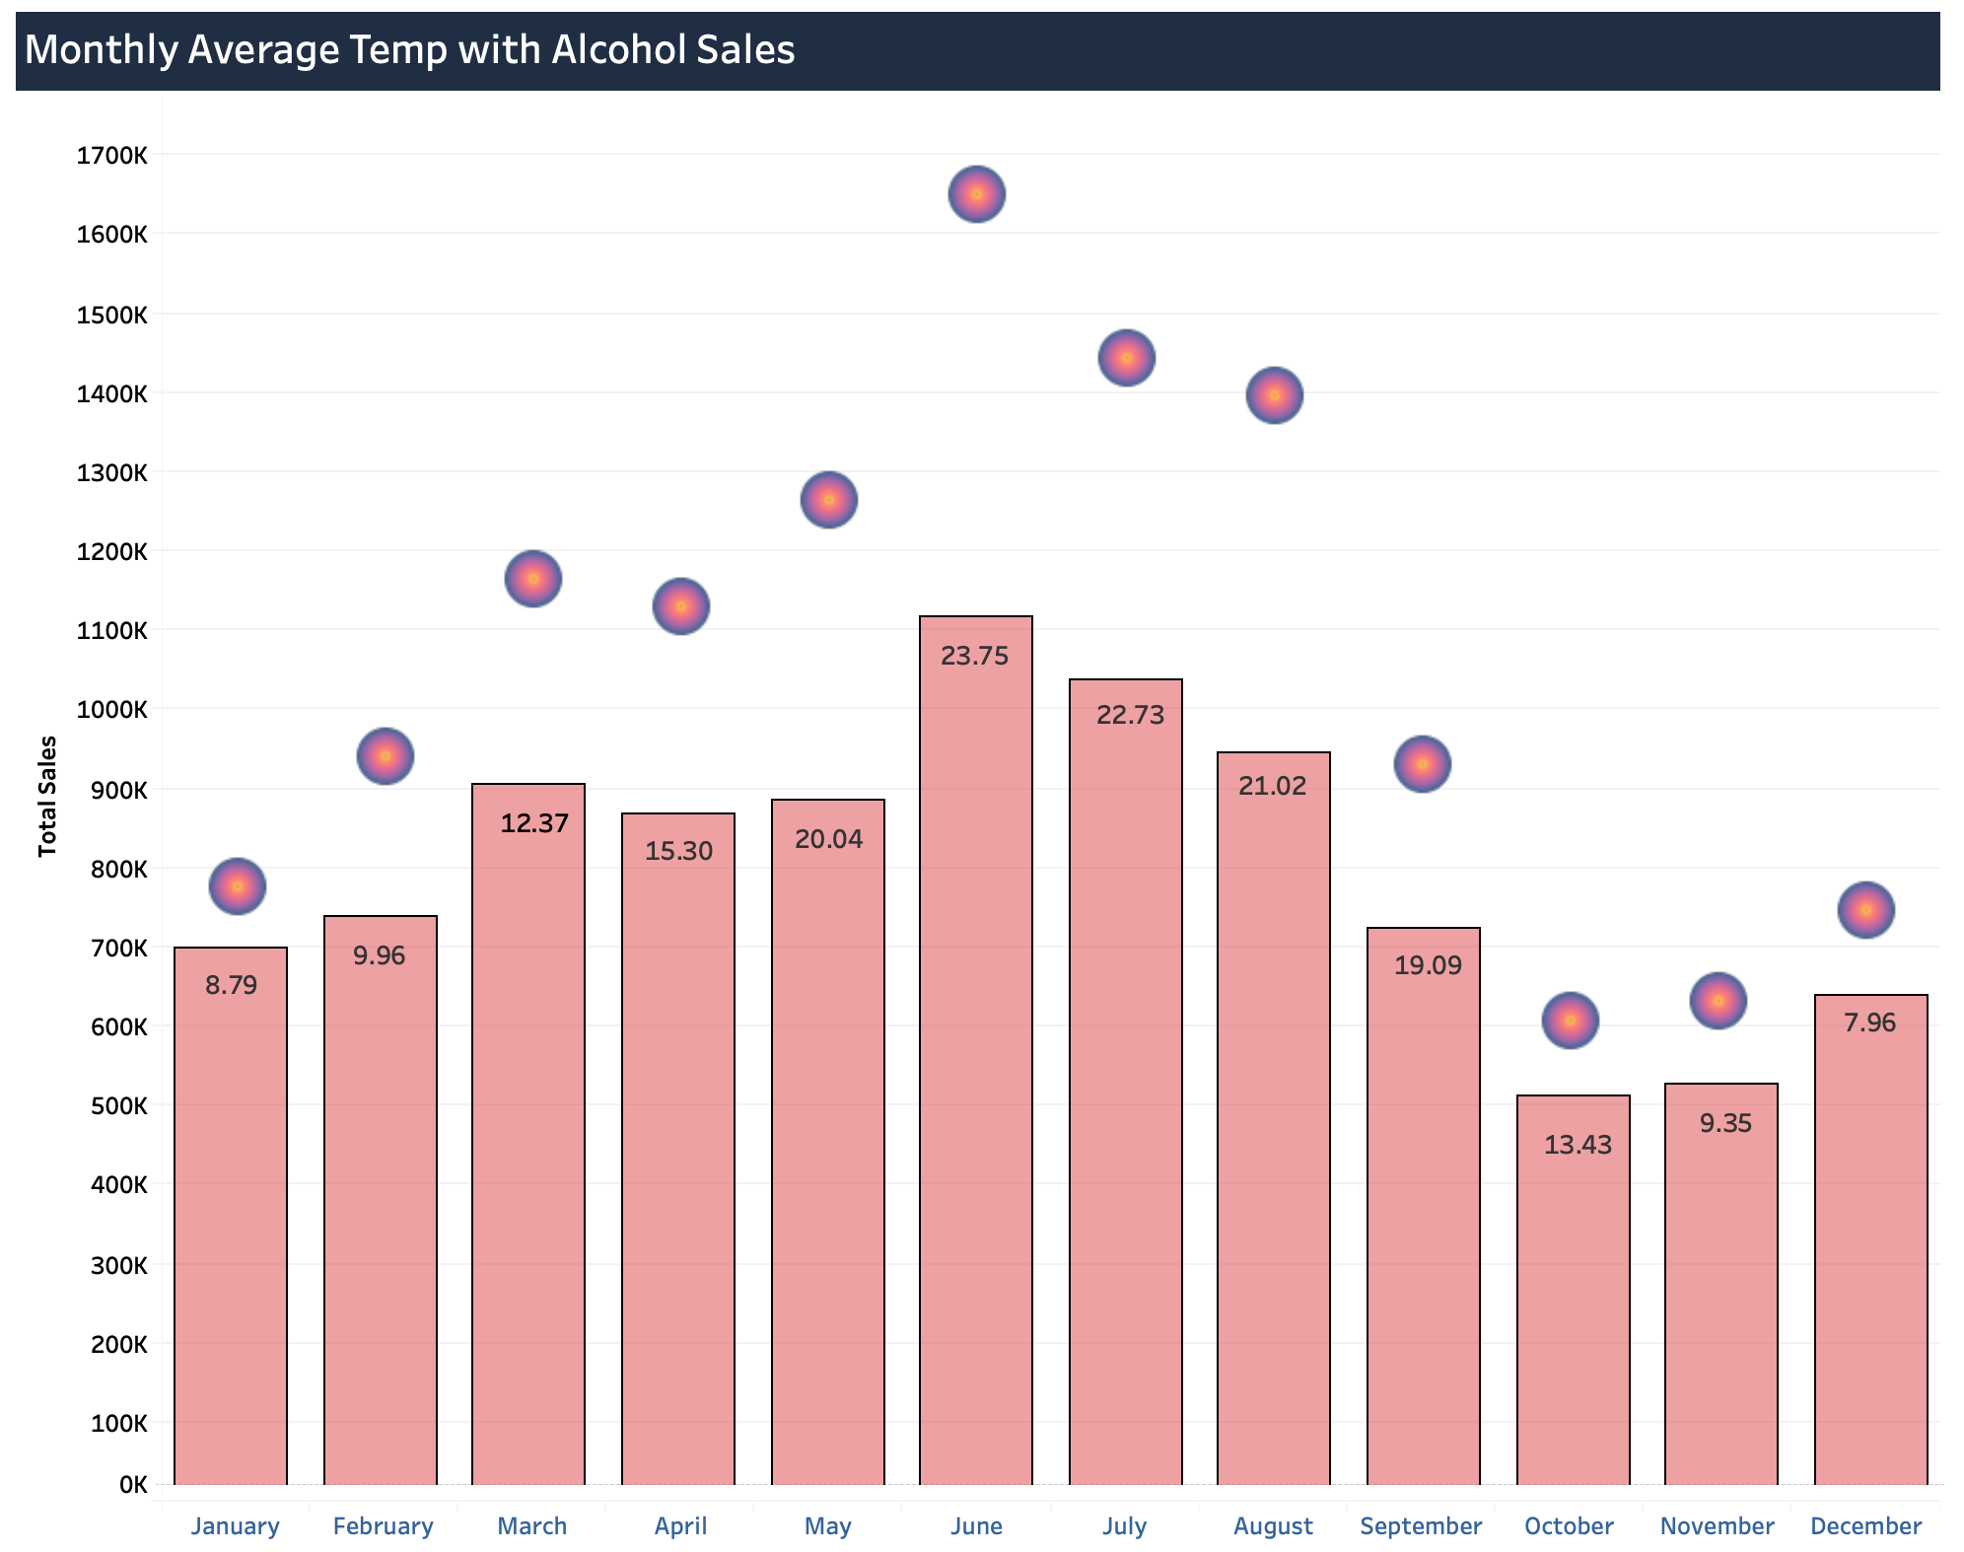
DUE TO TEMP AFFECTS

Slide 7
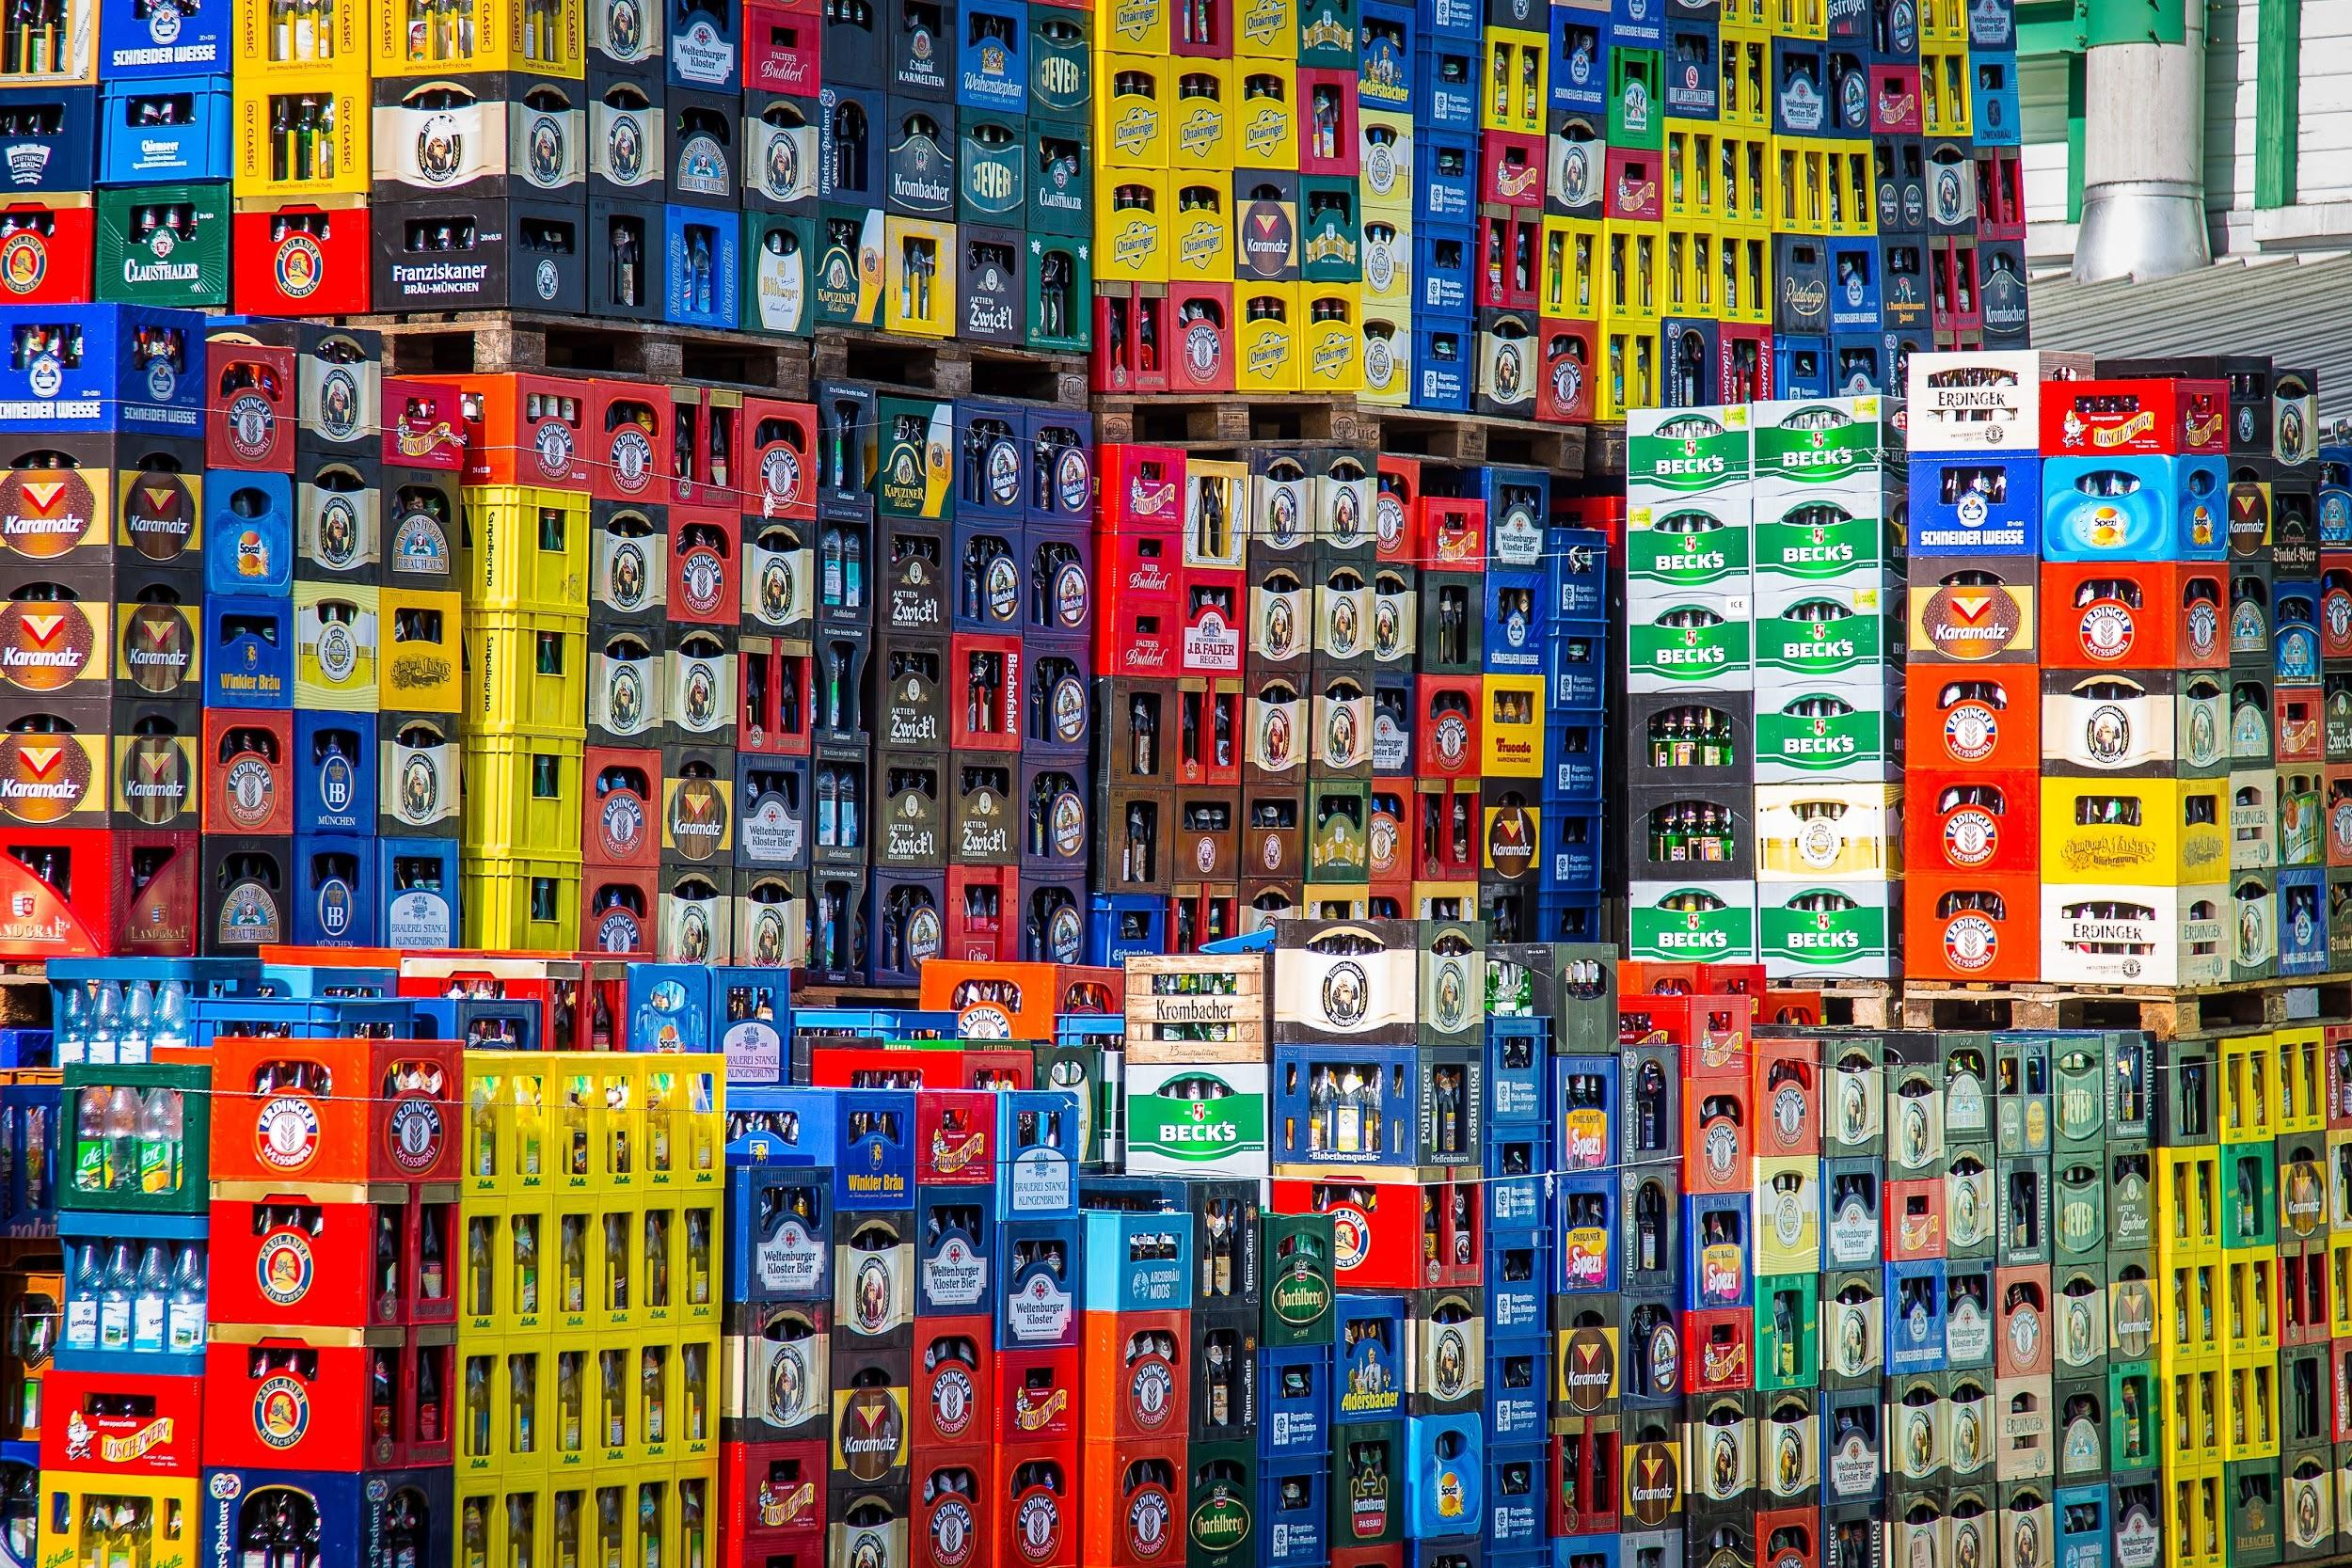
THE PLAYERS

Slide 8
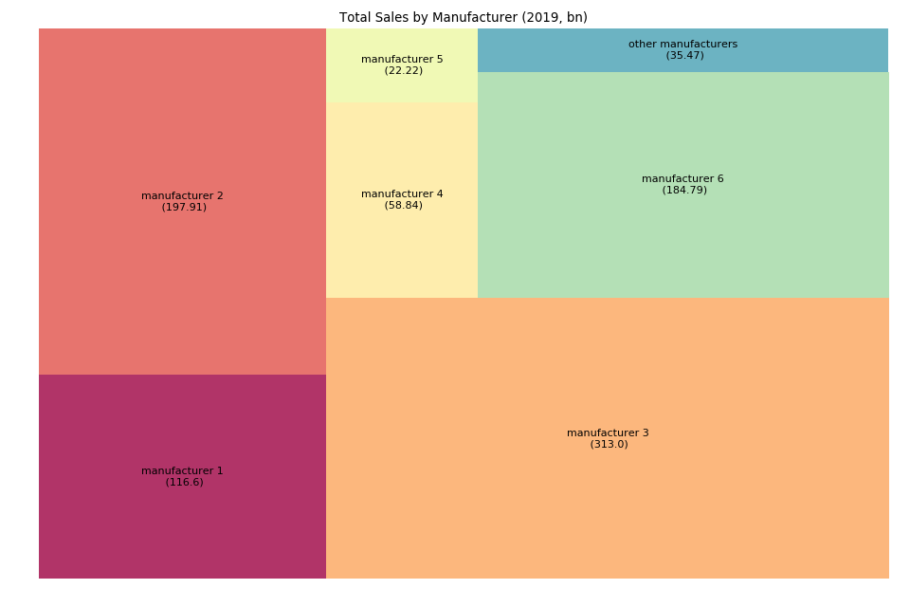
THE SPANISH BEER MARKET
THREE LARGE PLAYERS

Slide 9
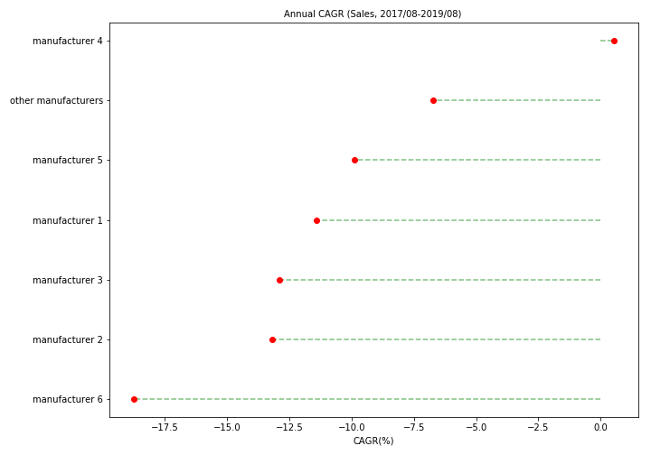
WITH DIVERGENT GROWTH

Slide 10
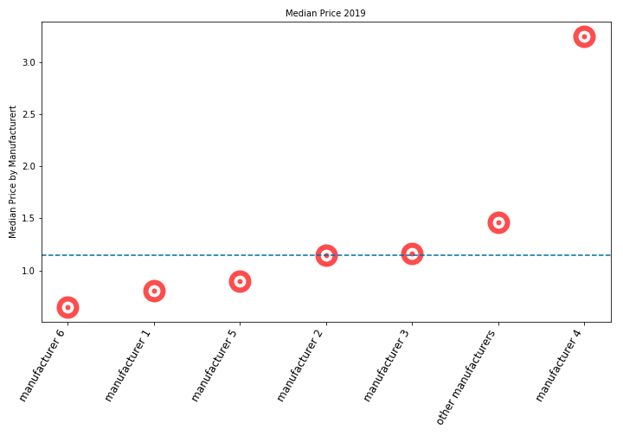
THE SPANISH BEER MARKET
AND DIFFERENT PRICING STRATEGIES

Slide 11
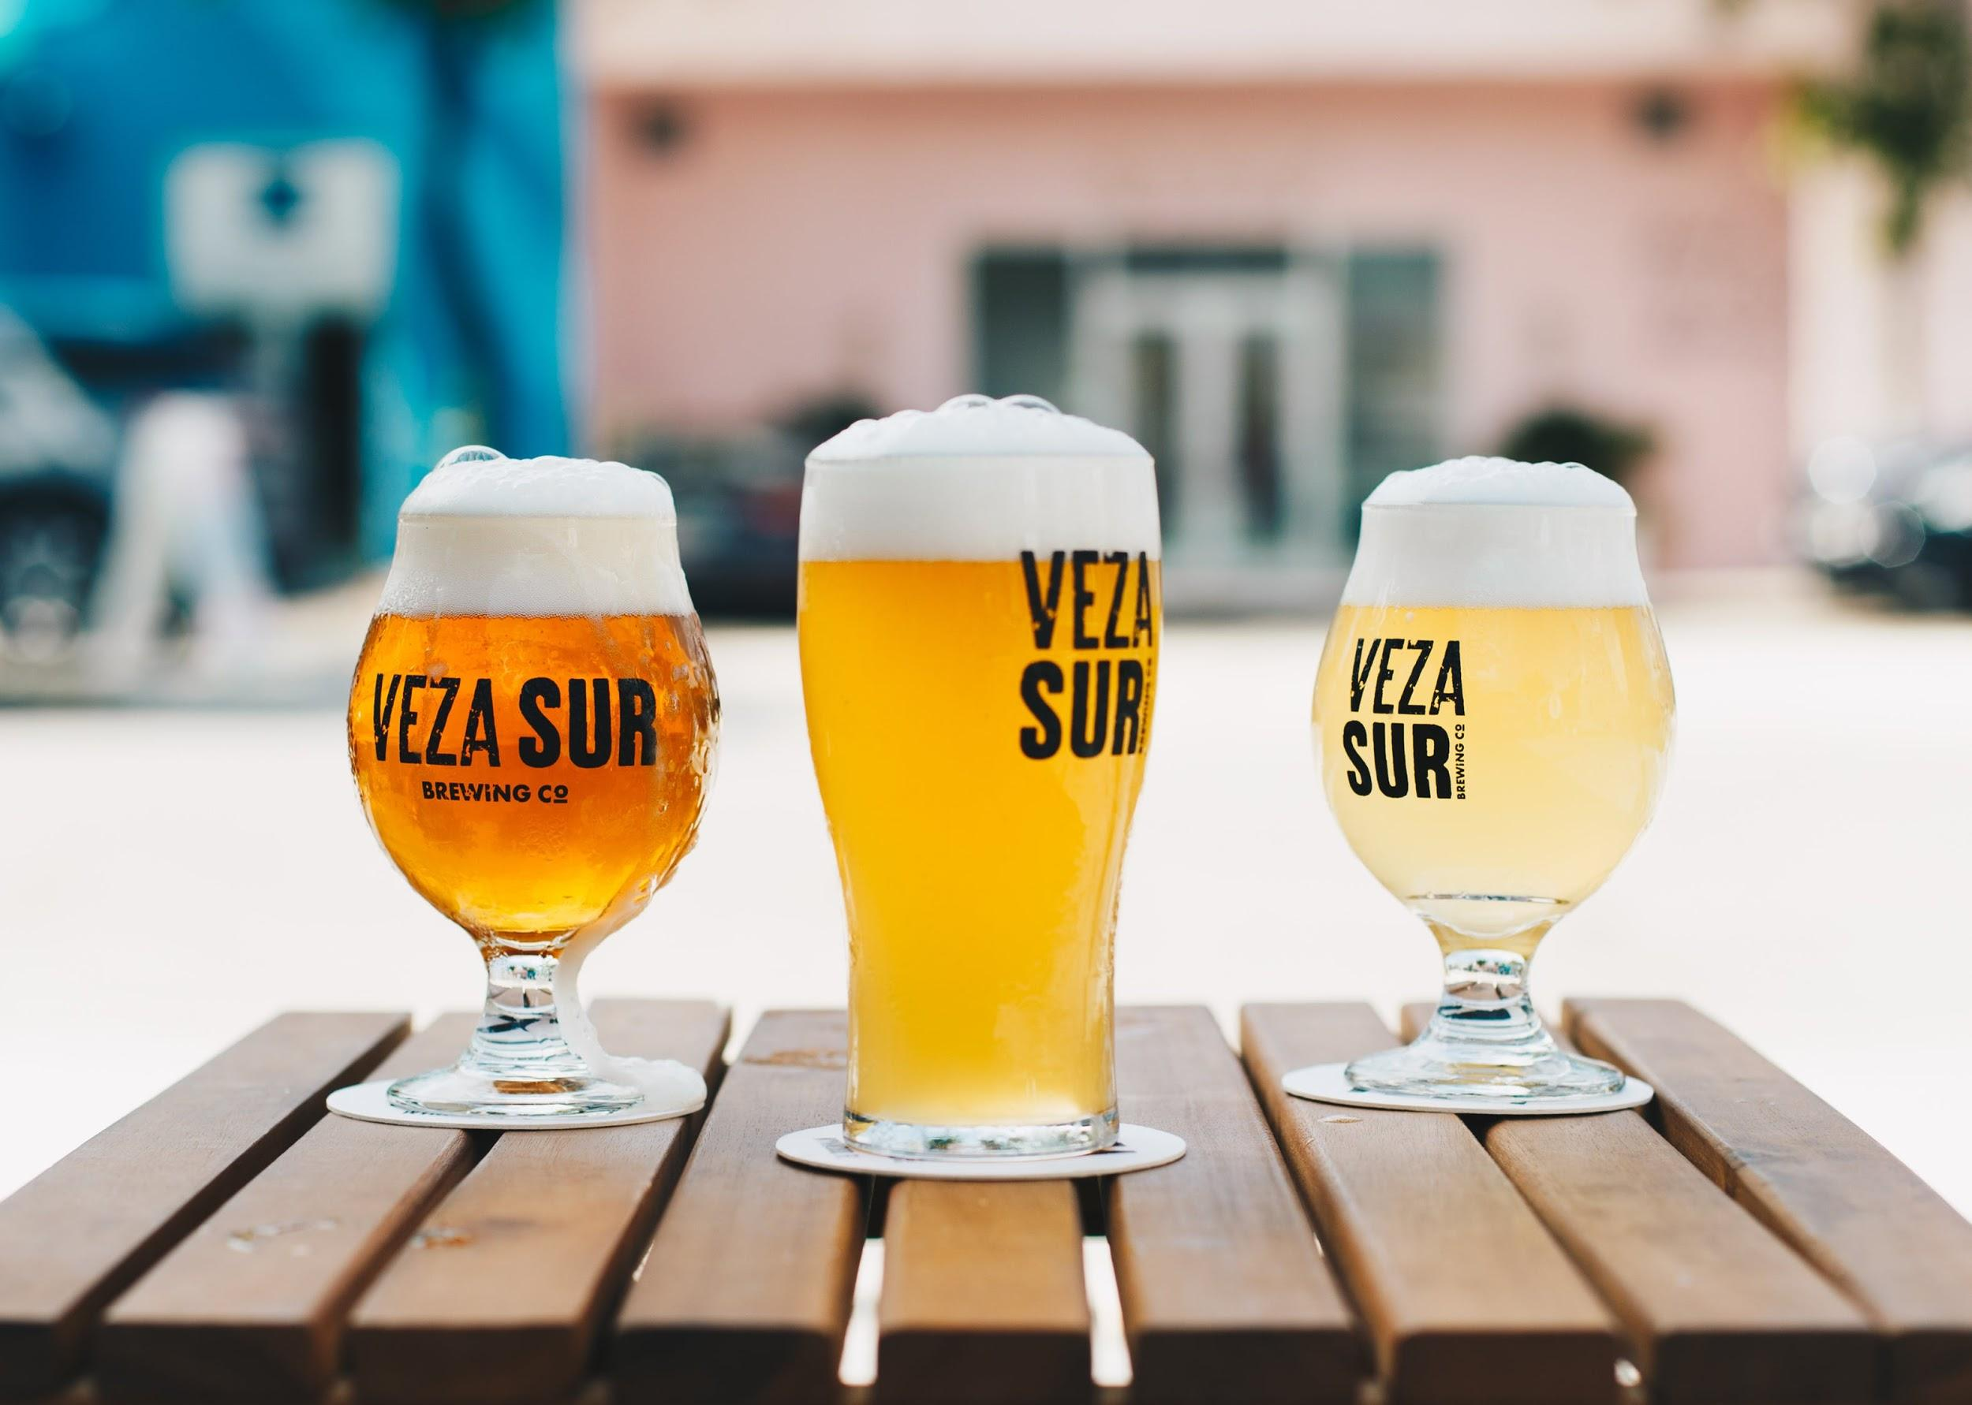
SEGMENTS

Slide 12
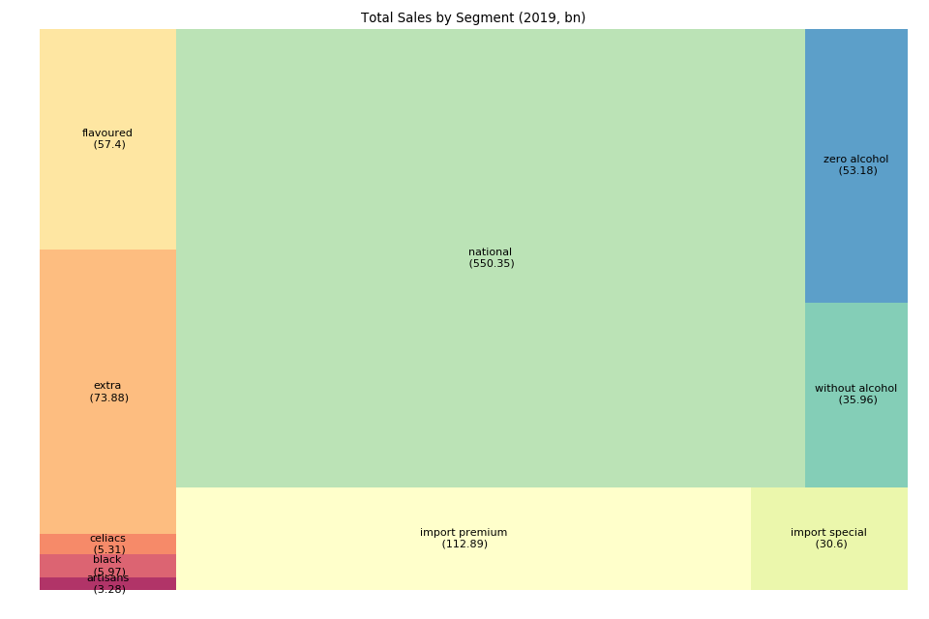
THE SPANISH BEER MARKET
NATIONAL DOMINATES

Slide 13
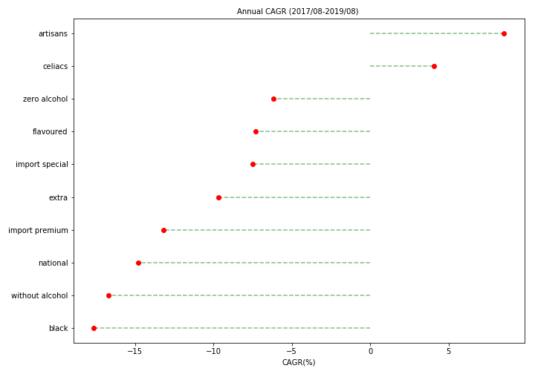
BUT THERE ARE NEW TRENDS

Slide 14
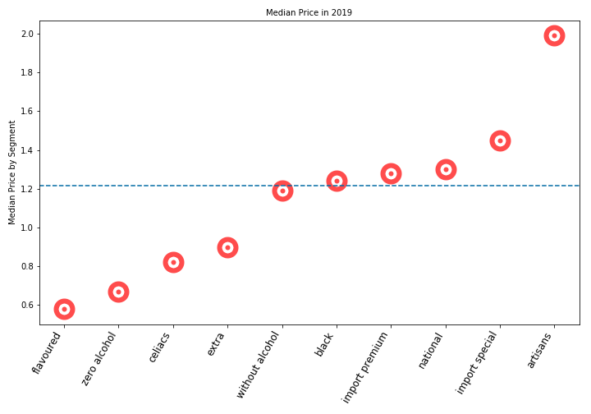
THE SPANISH BEER MARKET
SELLING AT PREMIUM AND DISCOUNT

Slide 15
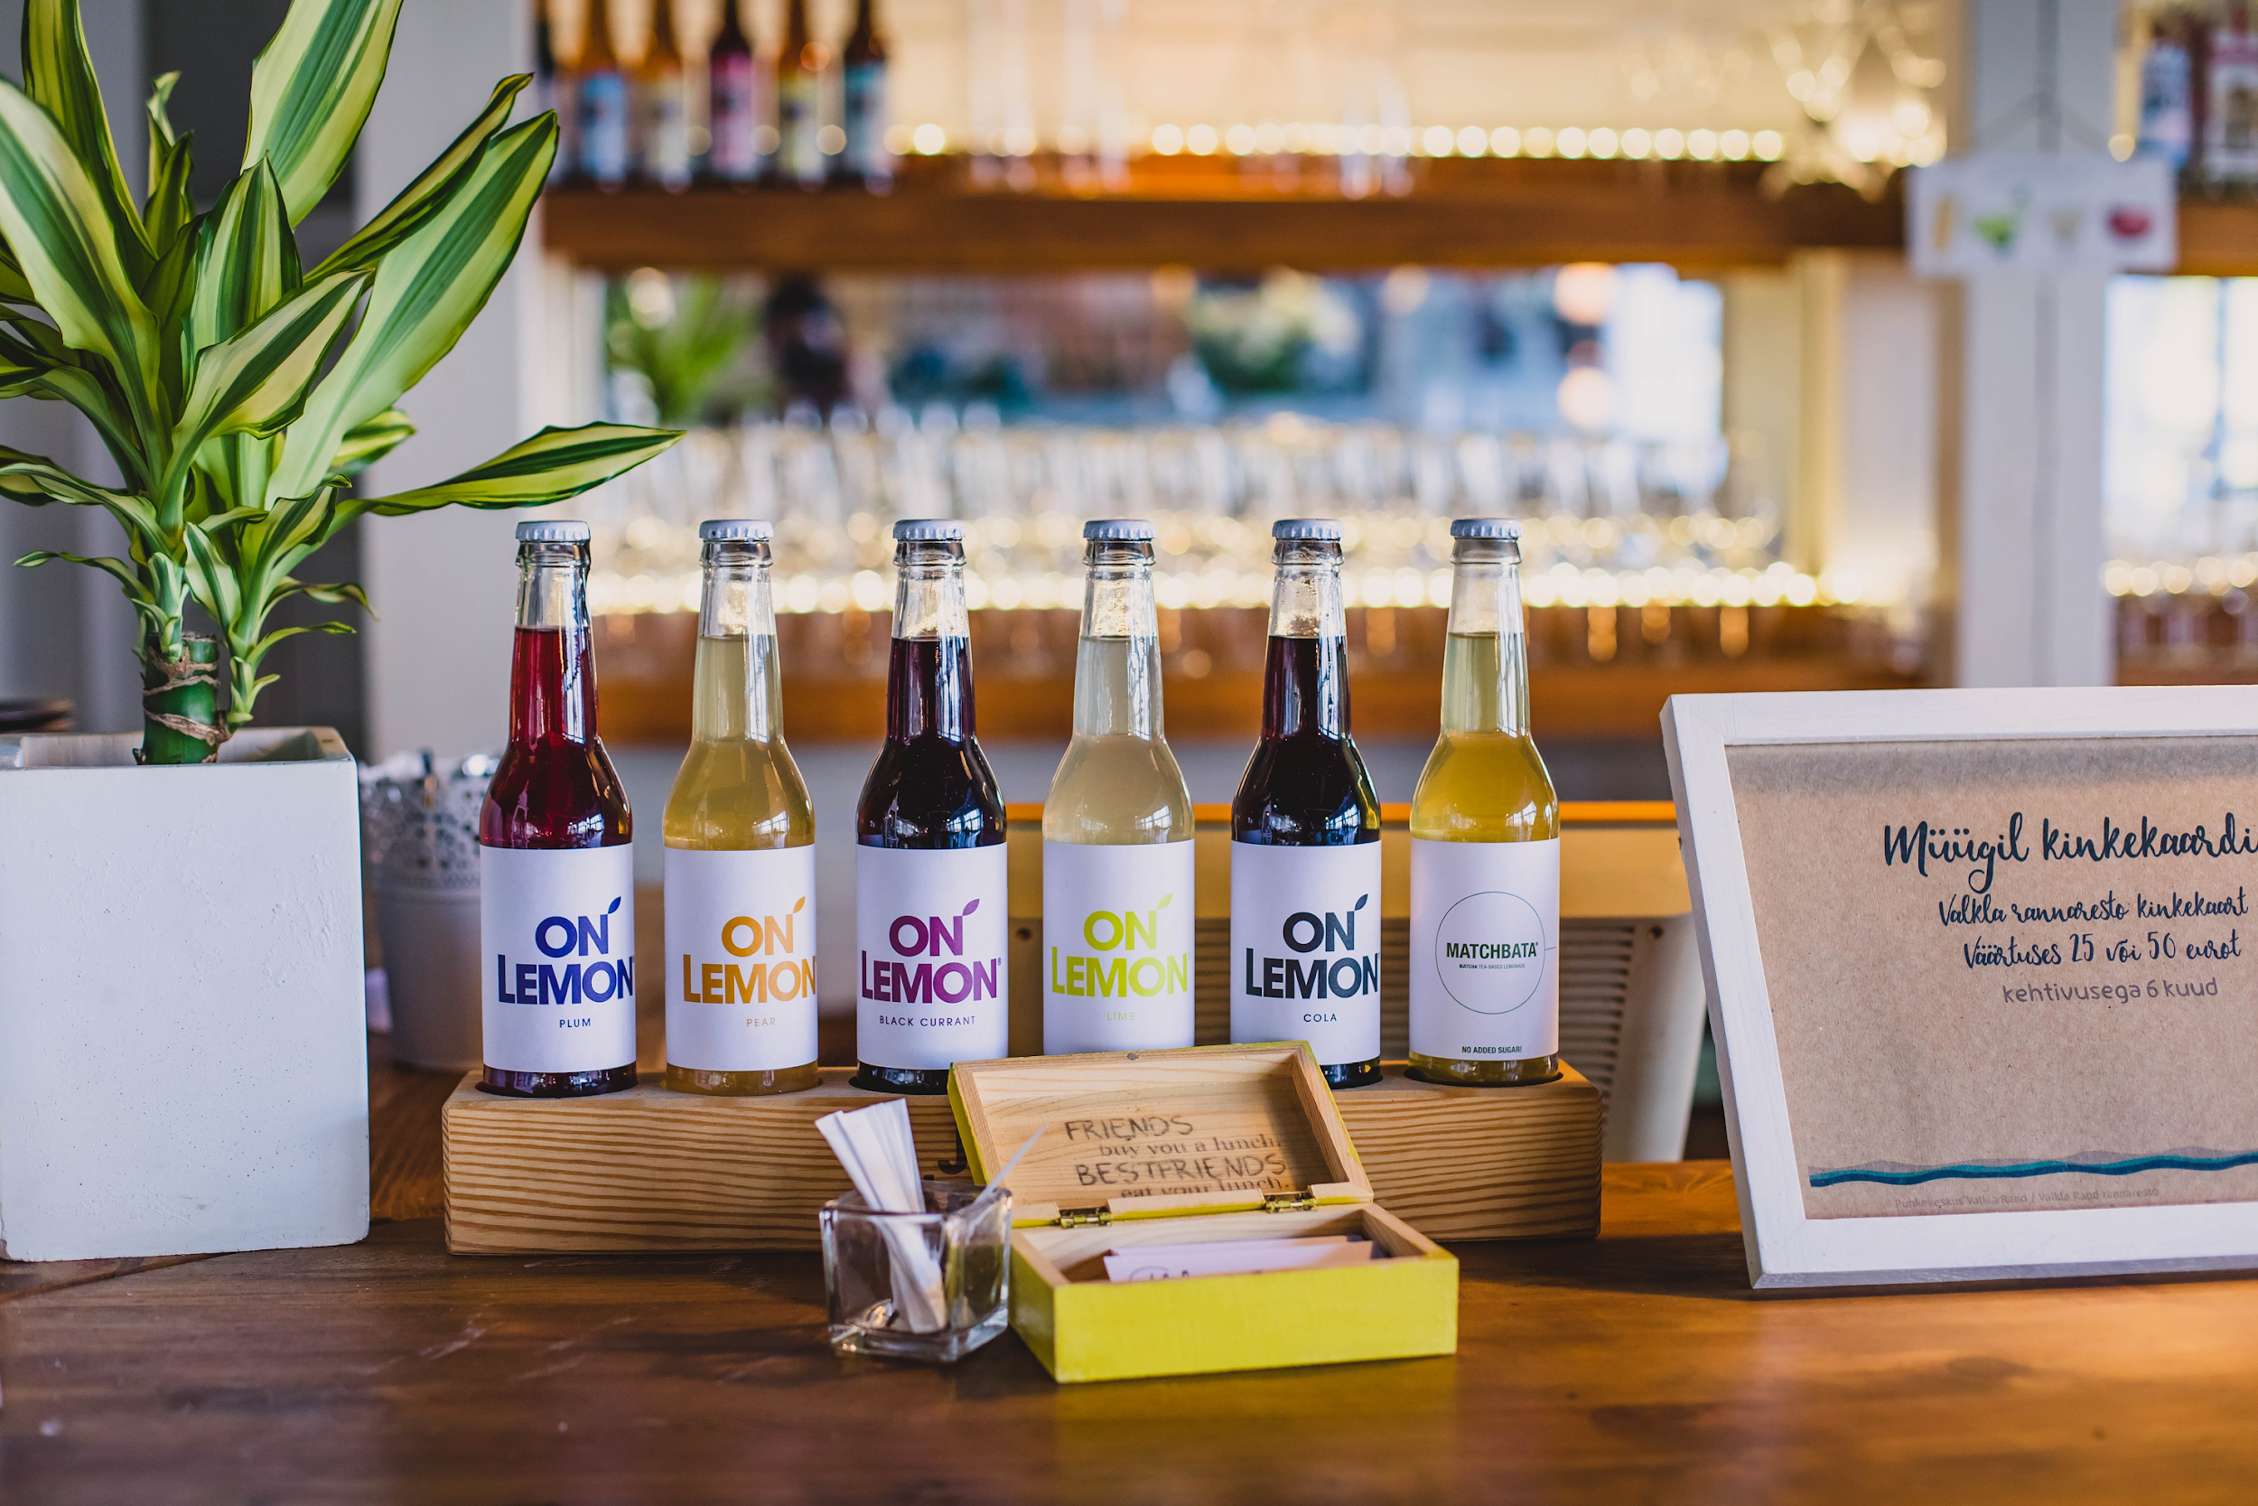
GROWTH OPPORTUNITIES

Slide 16
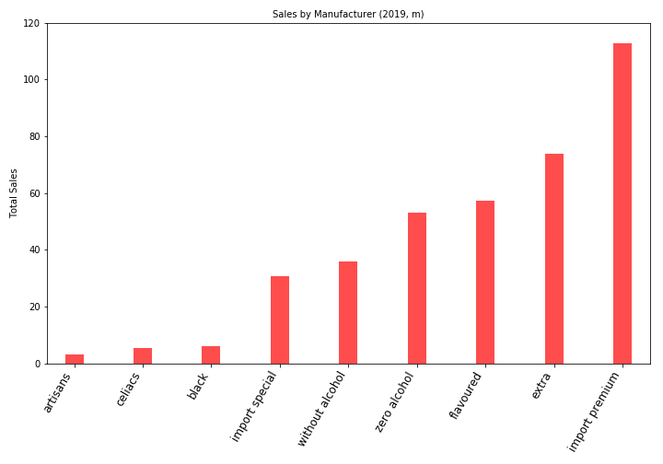
THE SPANISH BEER MARKET
EVERYONE DOES NATIONAL – SOME DIFFERENTIATE

Slide 17
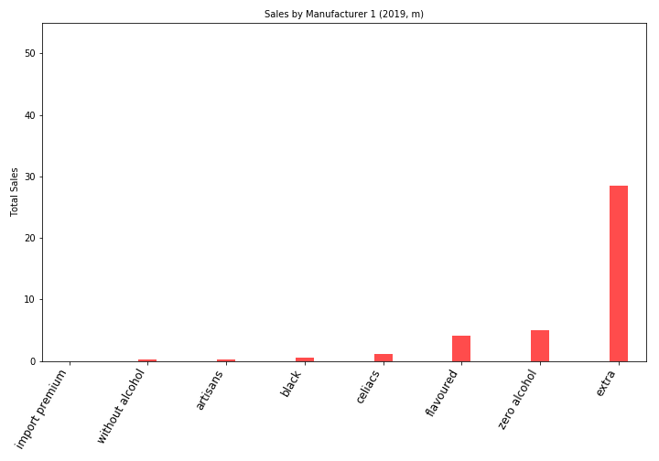
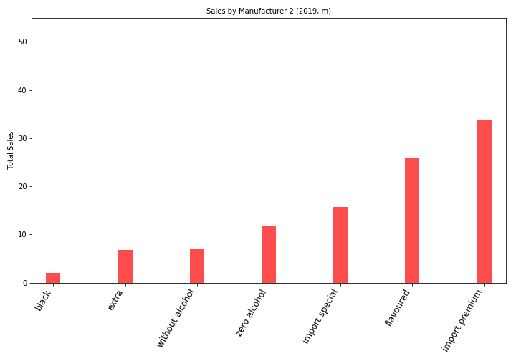
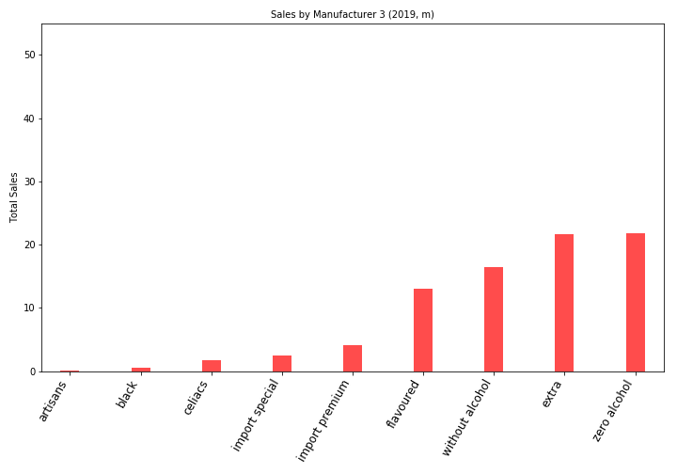
THE SPANISH BEER MARKET
LEADING SEPARATE SEGMENTS
1: Extra Leader
2: Import King
3: The Big Guy

Slide 18
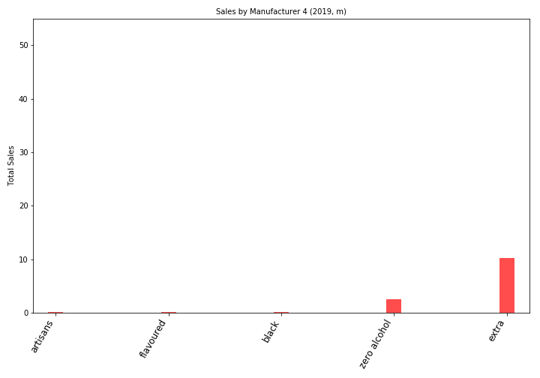
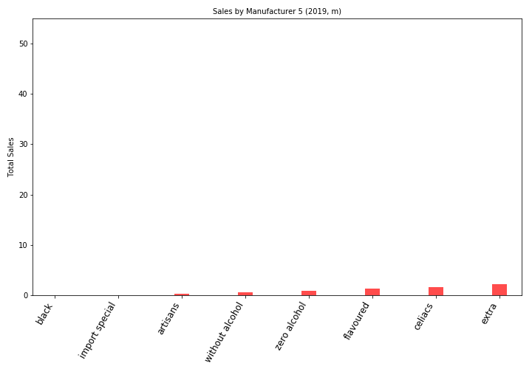
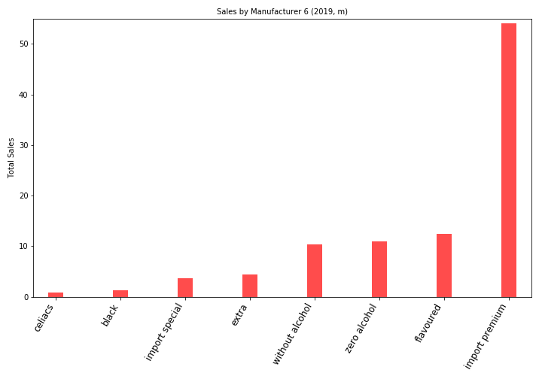
THE SPANISH BEER MARKET
LEADING SEPARATE SEGMENTS
4: The Underdog
5: Celiac Specialist
6: Premium Master

Slide 19
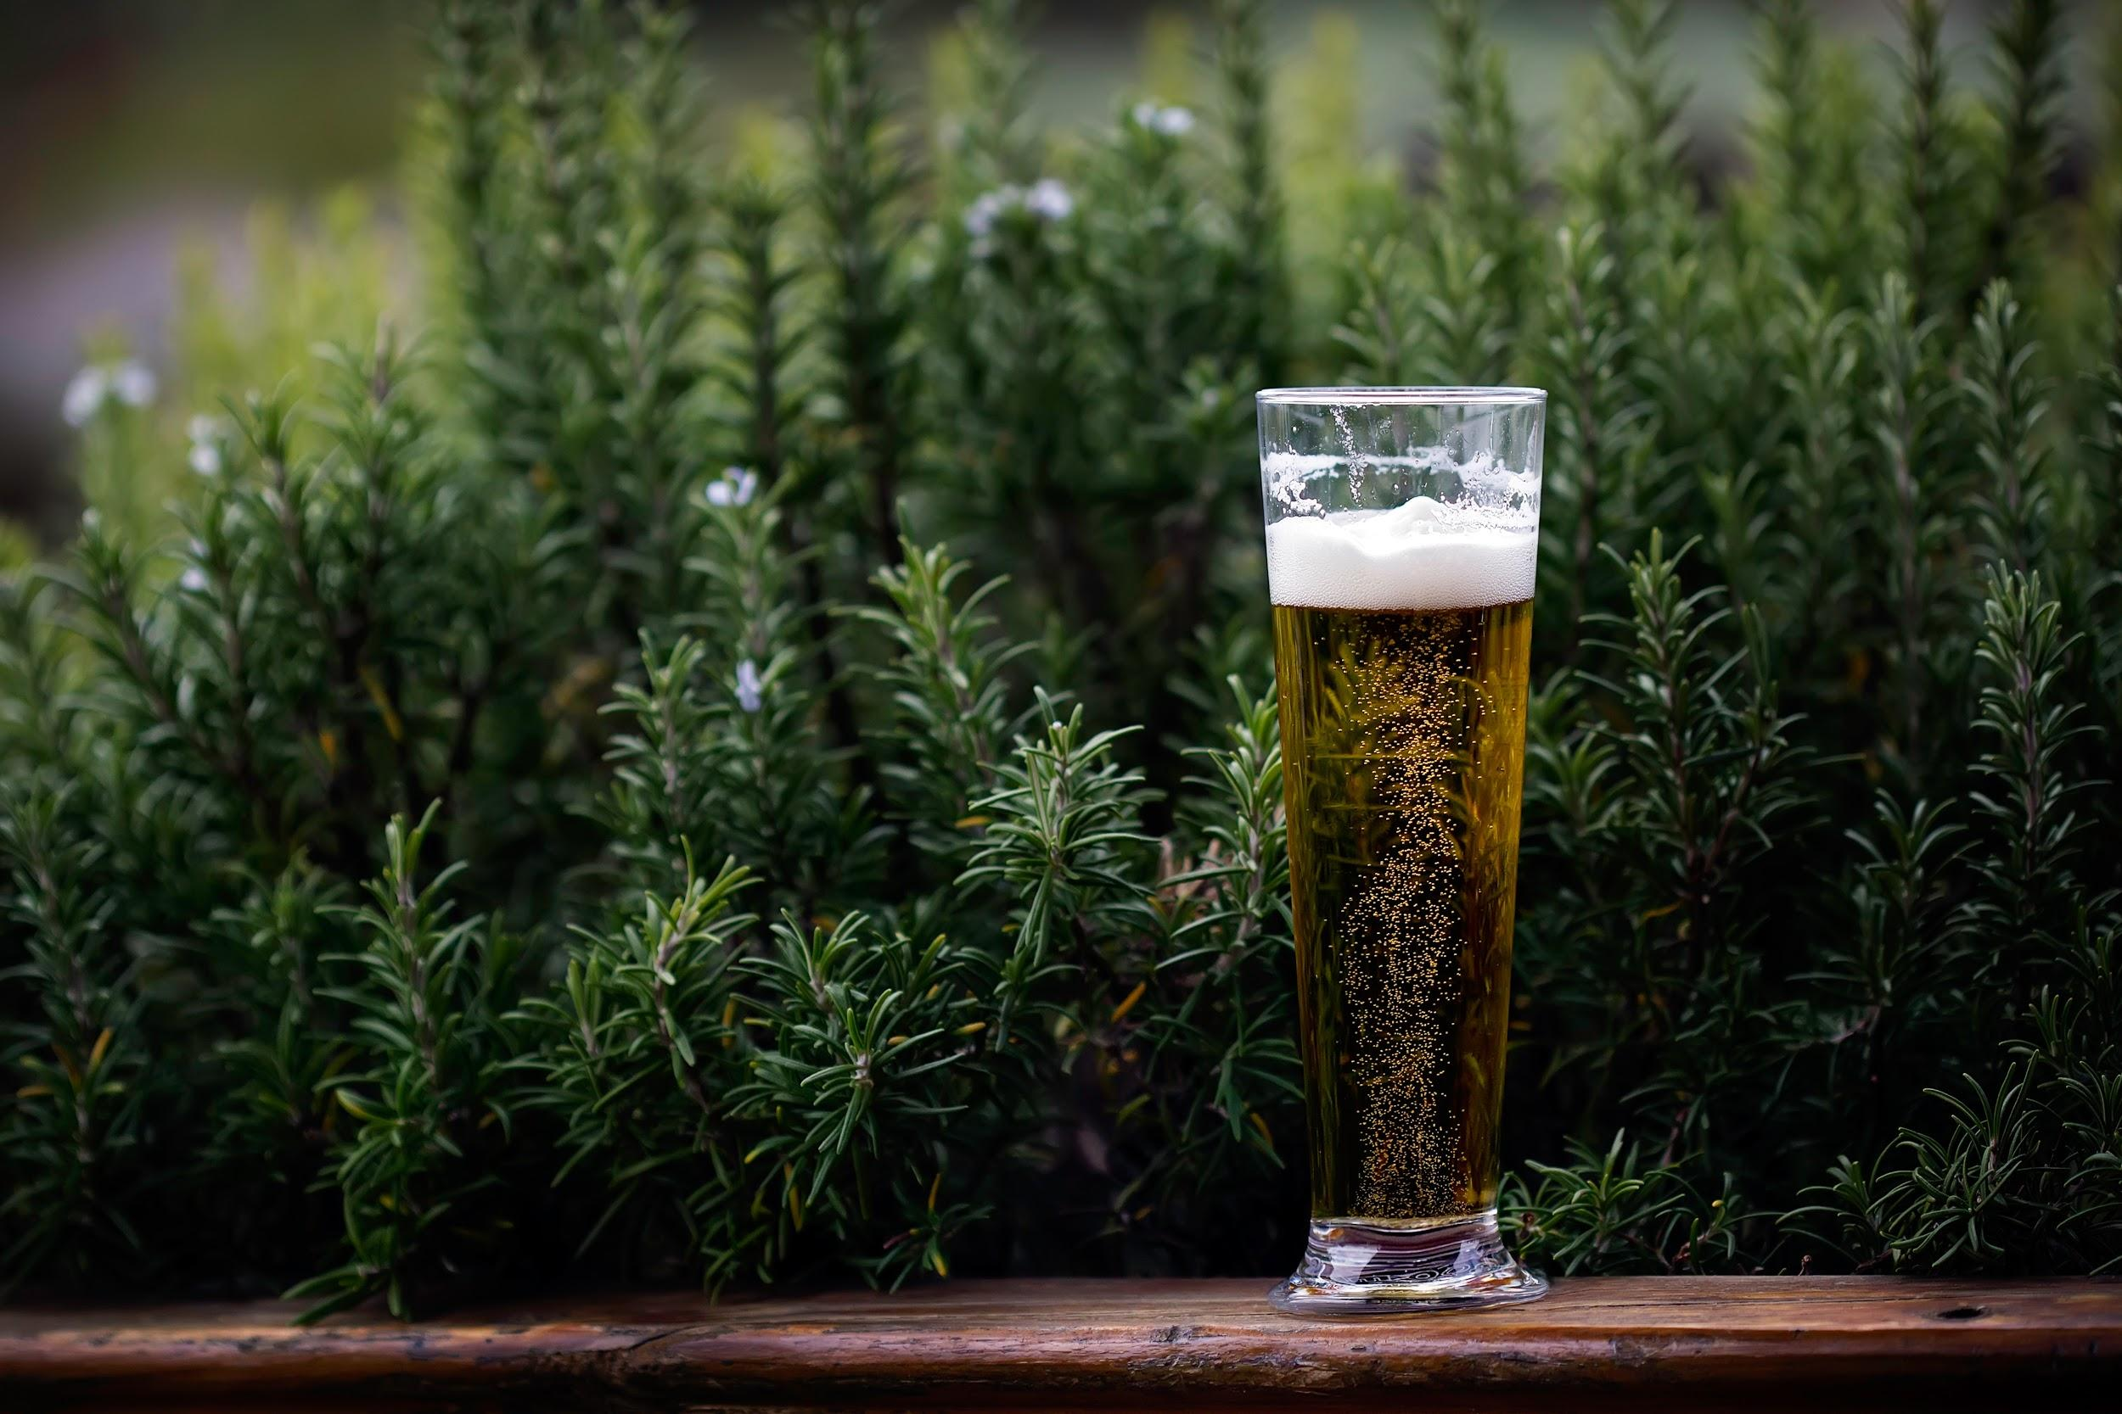
YOU - MANUFACTURER 4

Slide 20
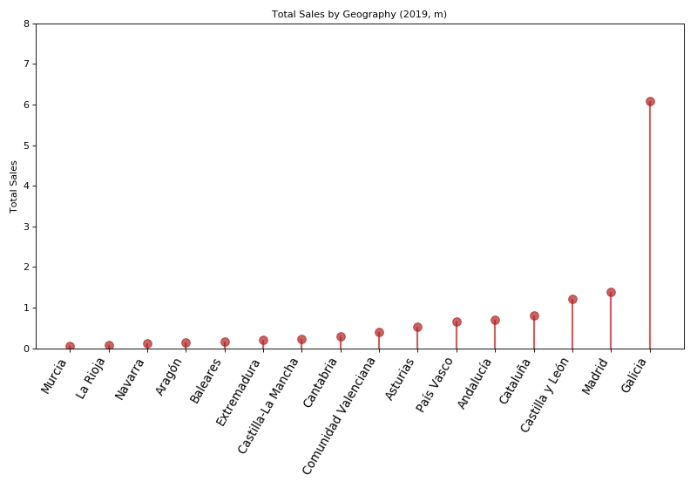
THE UNDERDOG
North-Western Focus
Premium Pricing
Growing
Notes:
Sales Value (2017): 0.98bn
Sales Volume (2017): 13.5m
Sales (2019): 2.6bn
Sales Volume (2019): 2.98m
Sales CAGR (2017-2019): 62%
Volume CAGR (2017): 48%

Slide 21
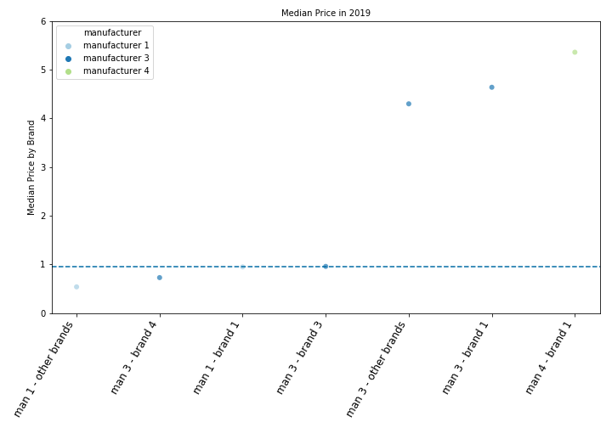
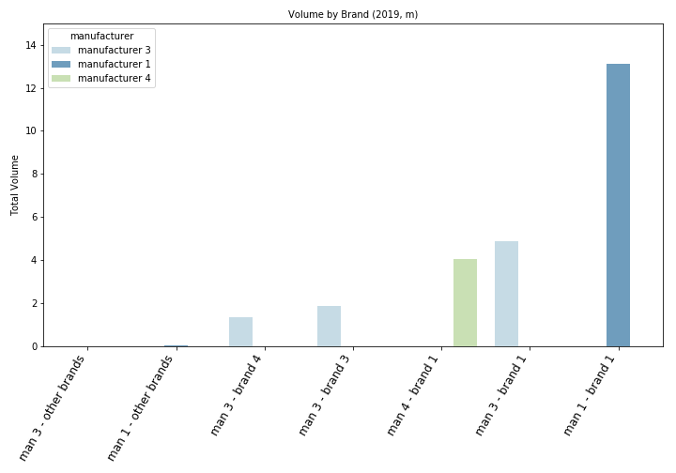
EXTRA: FOCUS ON PRICES
Notes:
Which is the impact on the Brand if a competitor’s product Price change?
In terms of pricing, Sinresa’s is also a premium manufacturer in this category. Manufacturer 3’s brand 4 is close second and Manufacturer 1 has the least priced products.
In this case lowest priced zero alcohol products (Manufacturer 1) are selling in high volumes
If a Manufacturer 1 decreases their price, they might see an increase in volume of their Brand 1. What is more important here is that Sinresa should consider significantly decreasing its prices if the goal is to spur volumes.

Slide 22
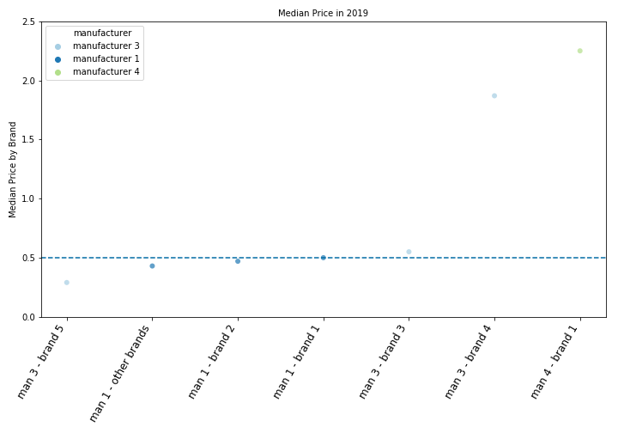
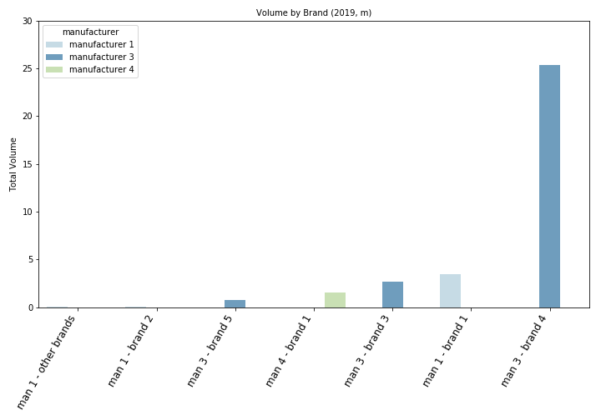
ZERO ALCOHOL: FOCUS ON BRANDING
Notes:
Which is the impact on the Brand if a competitor’s product Price change?
In terms of pricing, Sinresa’s is clearly a premium manufacturer in this category. Manufacturer 3’s brand 4 is close second and Manufacturer 1 has the least priced products.
The lowest priced zero alcohol products (Manufacturer 1) are not selling in high volumes
In fact a price of 1.75 (Manufacturer 3) seems to lead to the highest sales volumes, albeit it might also be because of Manufacturer 3’s marketing capabilities.
If a Manufacturer 1 increases their price, they might see an increase in volume. What is more important here is that Sinresa should consider reducing its prices a little to spur volumes.

Slide 23
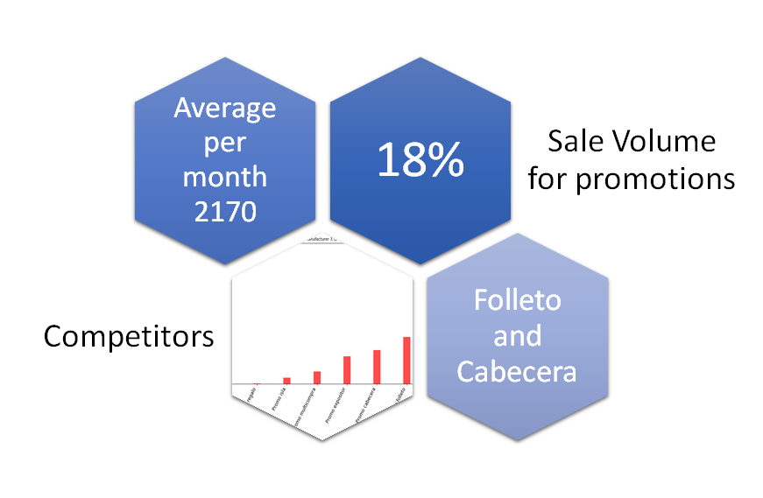
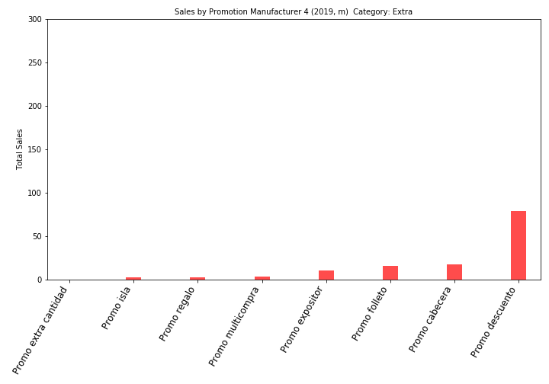
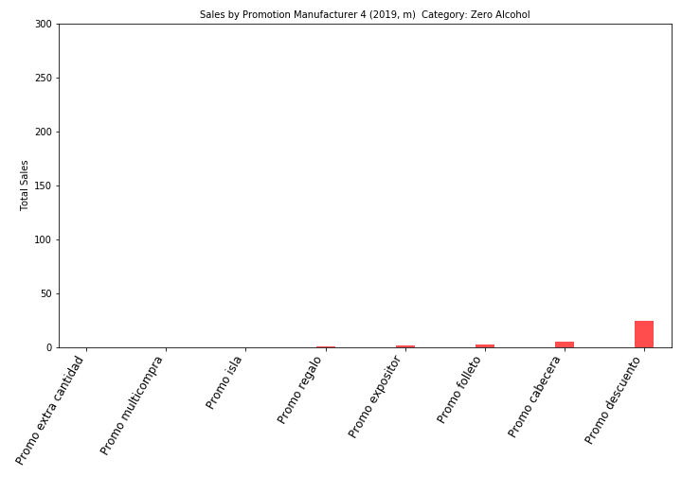
PROMOTIONS: DISCOUNTS
Notes:
Which promotional mechanics Works the best?

Slide 24
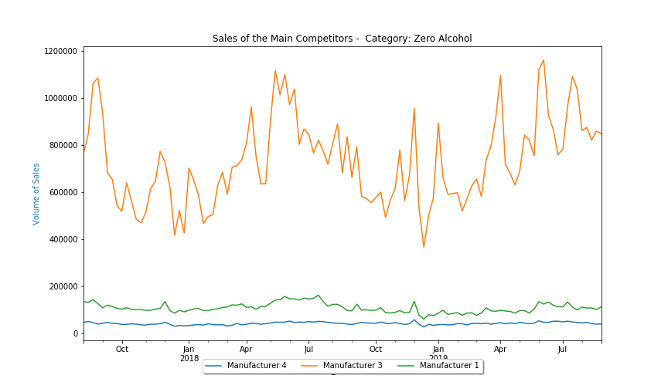
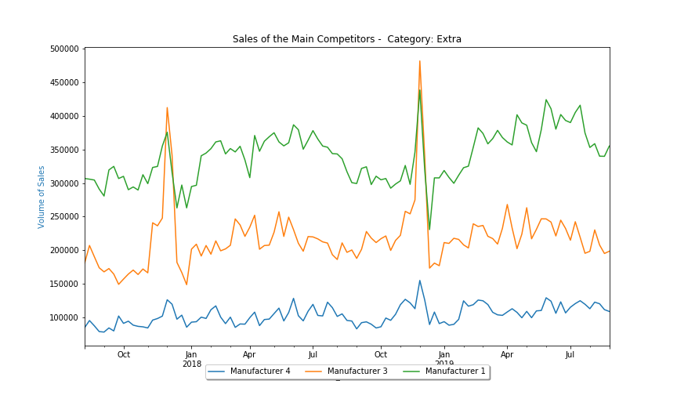
PROMOTIONS: WORK WITH SEASONALITY
Notes:
What is the best season to promote the category? JANUARY BITCH

Slide 25
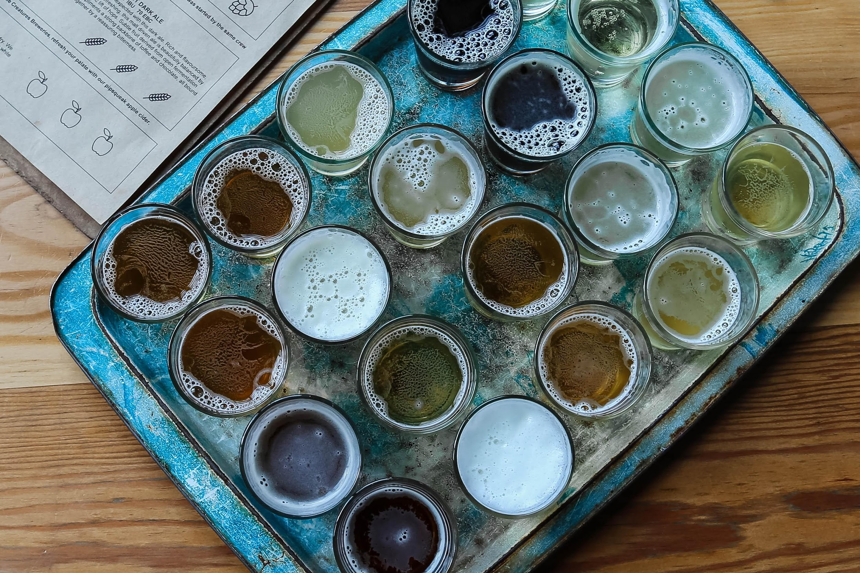
STORE SEGMENTATION

Slide 26
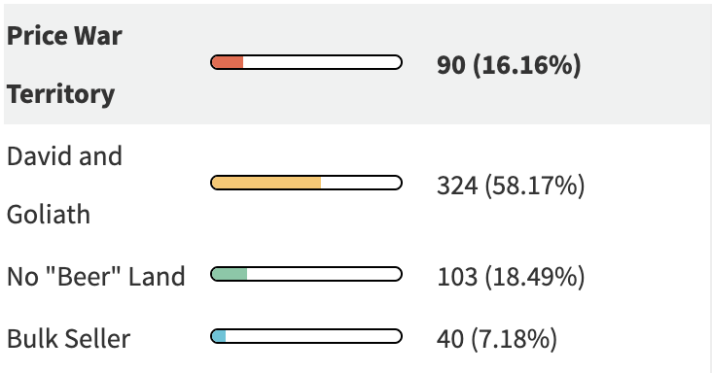
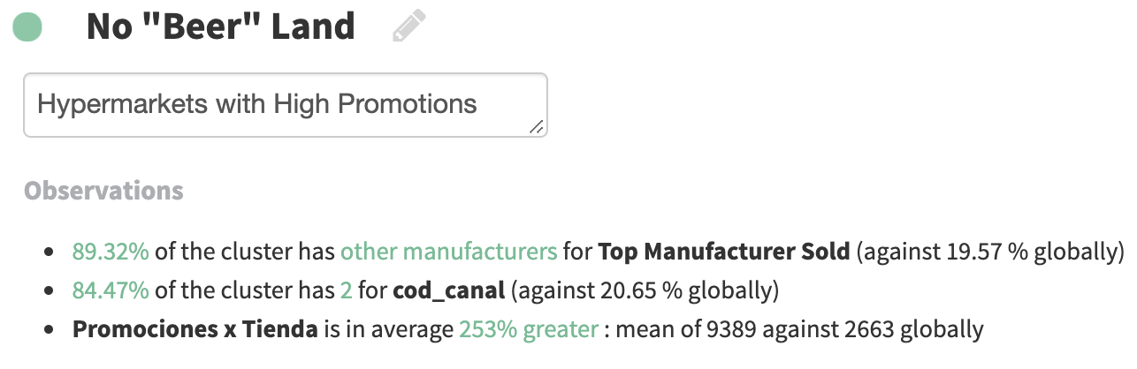
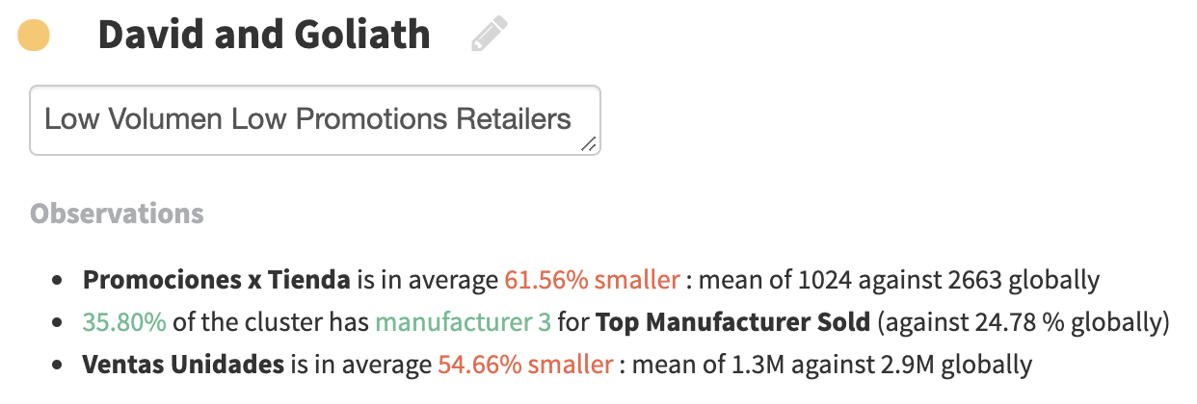
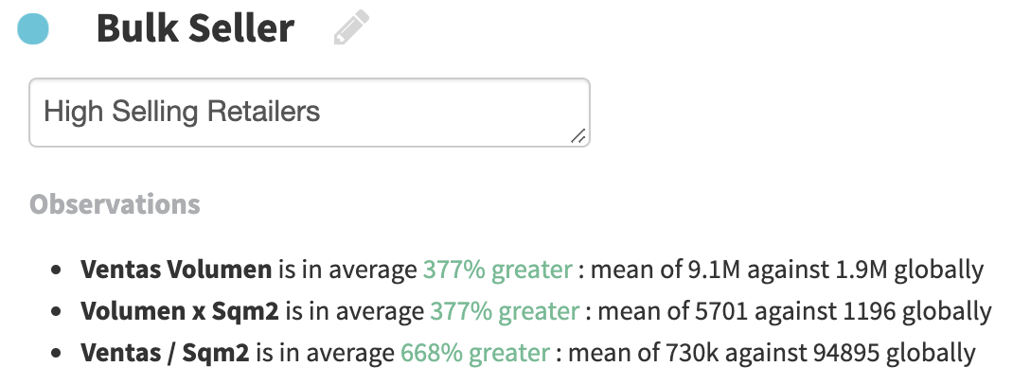
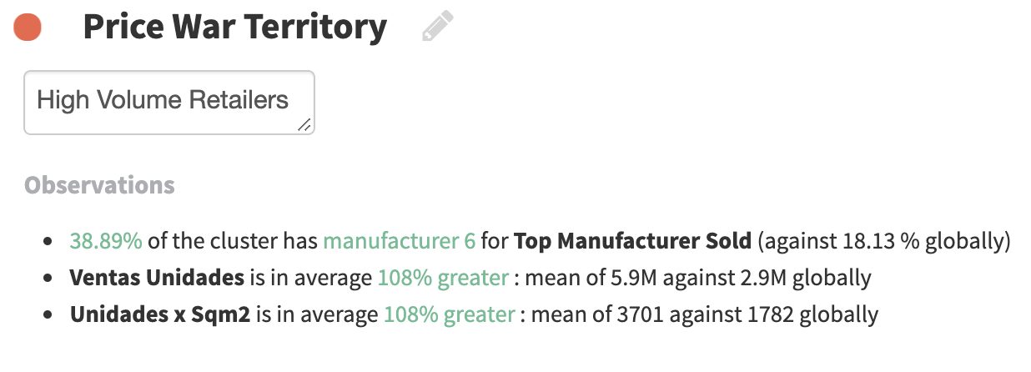
4 Types of Stores

Slide 27
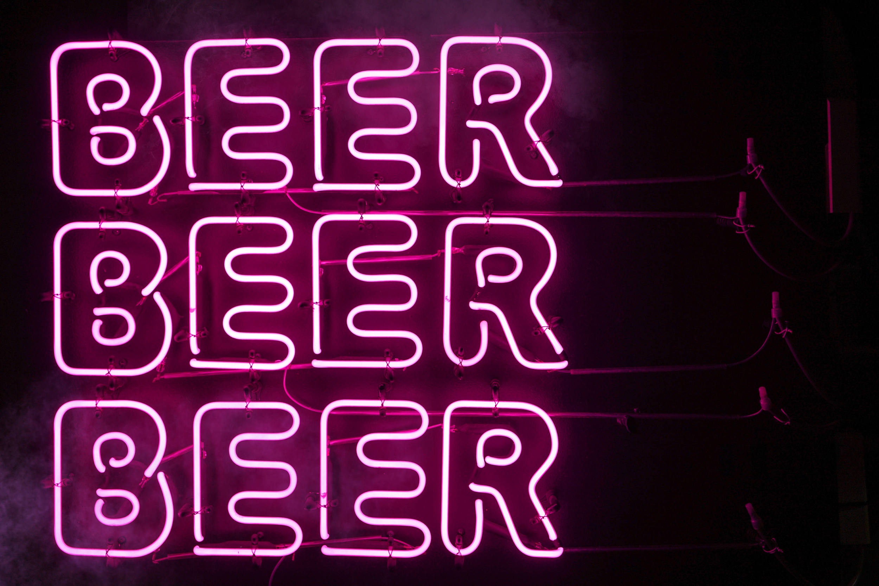
A VIEW TO THE FUTURE

Slide 28





Consumer Insights
Brand is Key
Discounts work to change brands
Personal well-being
Household Profile Change
Less Variety
Notes:
The trust in their personal well-being is high but not in the economy of the country
The brand is usually what the consumer focus on but can be encourage to change by discounts.
Variety and quantity are not something they would focus on
Consumer prefers low variety to choose ( when high variety they tend to go just focus on their preferred brand).
Promotions can make them change brands but not the amount they want to buy.

Slide 29
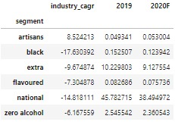
A WAY TO FORECAST – INDUSTRY CAGR
Notes:
How can I forecast future sales trends and the main categories overall?

Slide 30
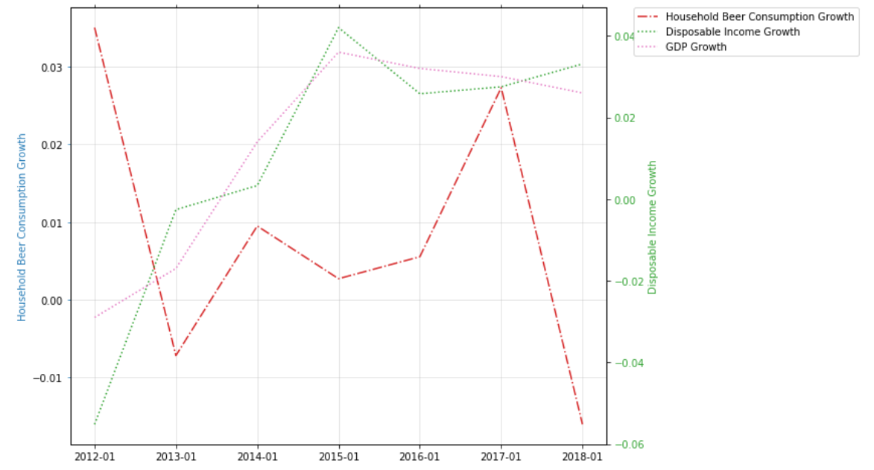
BE WARY OF DISPOSABLE INCOME
Source: Eurostats, Statista, FMI
Notes:
How do external factors like economy, consumption habits, weather.. Influence my sales performance?

Slide 31
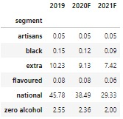
IT CAN DECREASE STORE SALES
Source: Eurostats, Statista, FMI
Notes:
How do external factors like economy, consumption habits, weather.. Influence my sales performance?

Slide 32
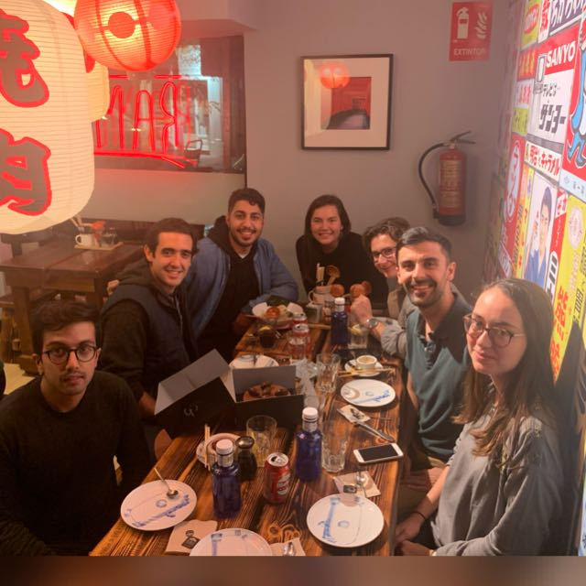
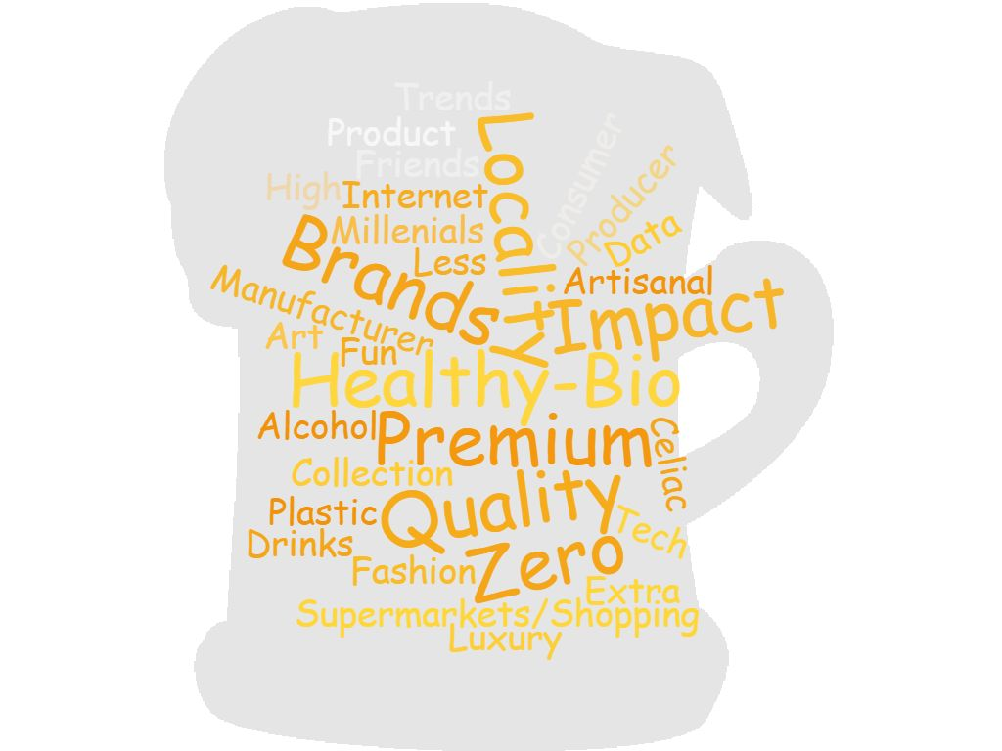

Slide 33
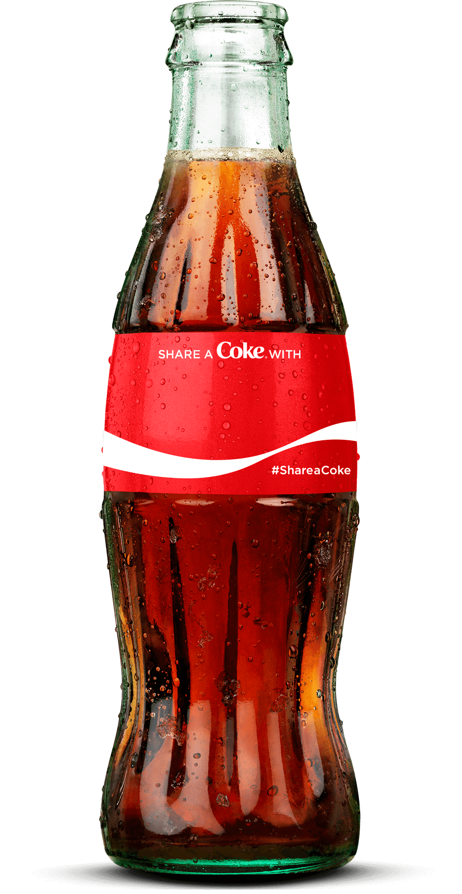

Slide 34
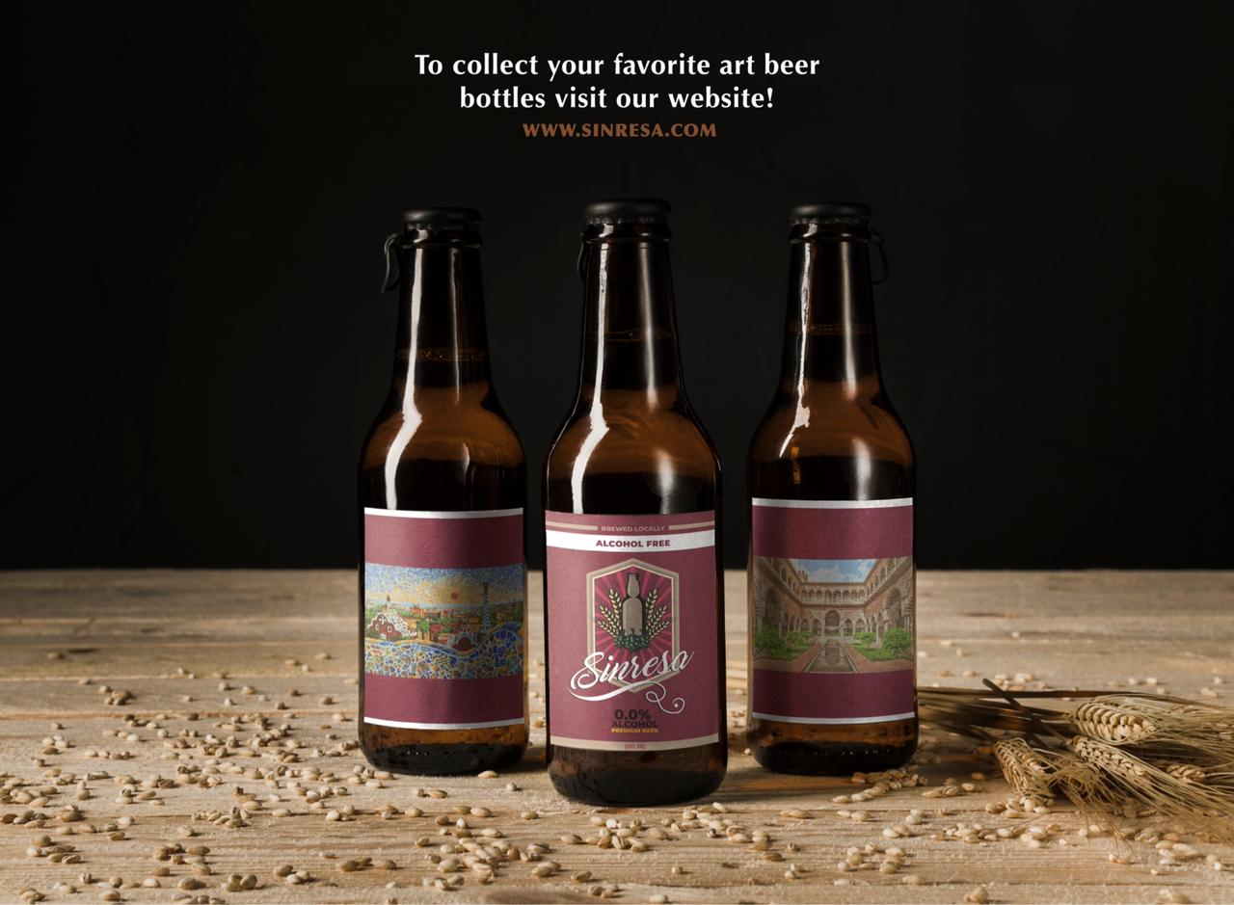
Locally Brewed
Need Premium Branding
Personalized Artist
Artisan and Zero Alcohol

Slide 35
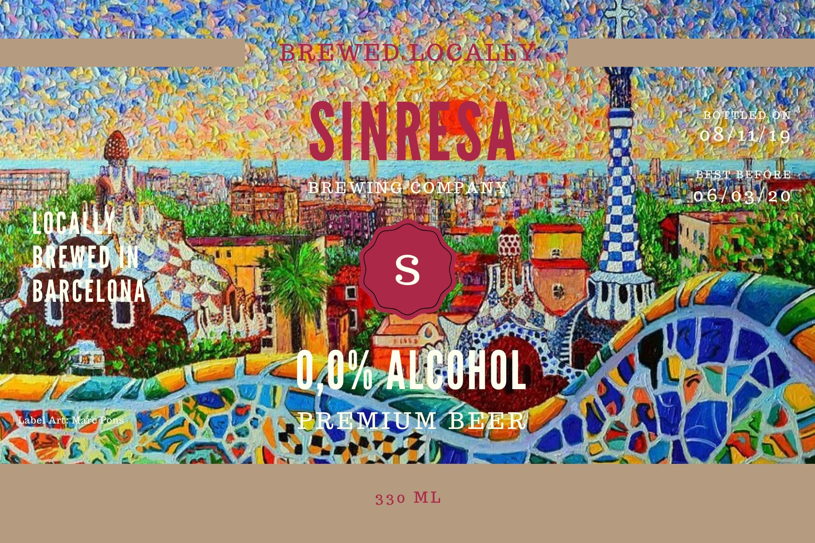
Notes:
Based on the trends and your actual position we are confident this strategy will take your company to next stage of growth.

Slide 37
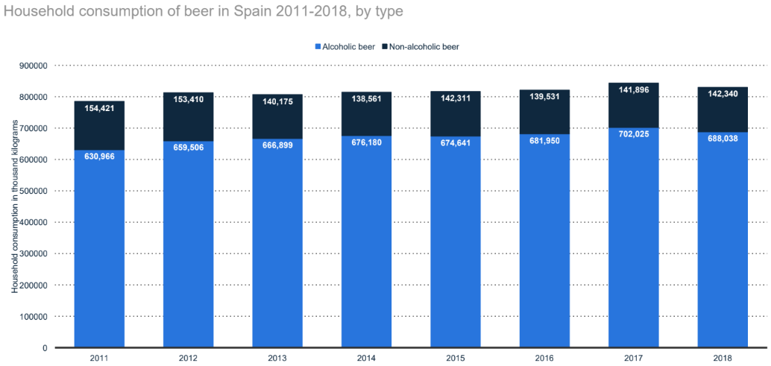
Zero and without alcohol
Spain is a leading market for this categories.
Considered healthy and the way is served does not affect the flavour.
Spanish beer culture is centered around social gatherings and food.
Spain is leader in non-alcoholic beer exportation.

Slide 38
